Slide 1





Evaluation of visual acuity with multifocal catenary curve-based contact lens design in different degrees of astigmatism
Gonzalo Carracedo, PhD
Professor Faculty of Optics and Optometry
University Complutense of Madrid

Slide 2
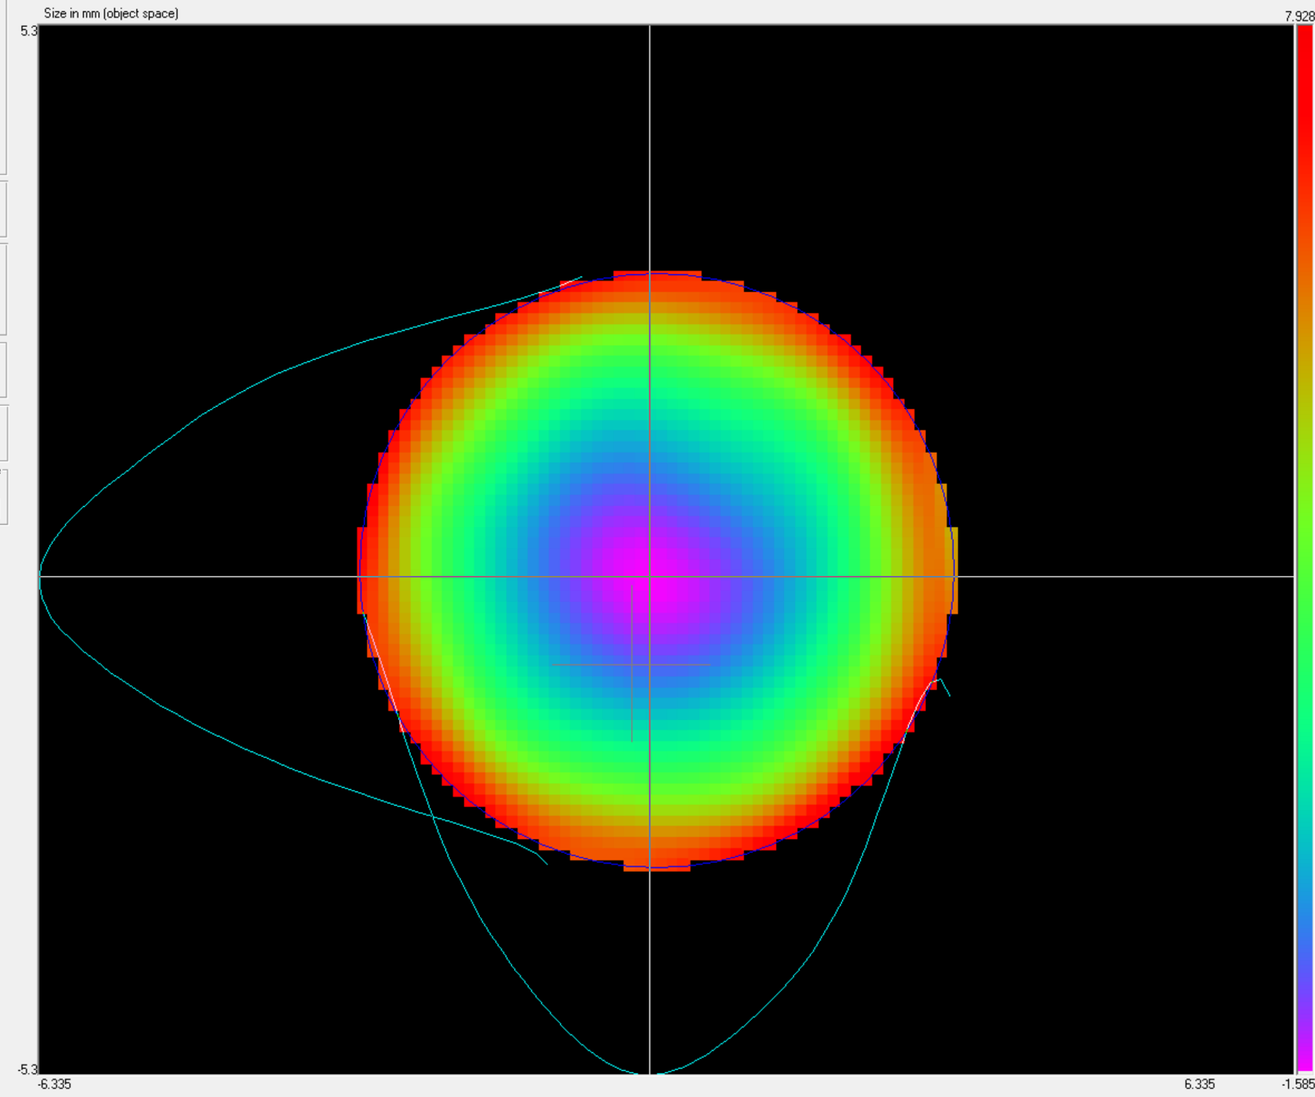
Catenary Power Profile
+8.00 D at 6mm diameter
Hartmann-Shack Aberrometer

Slide 3
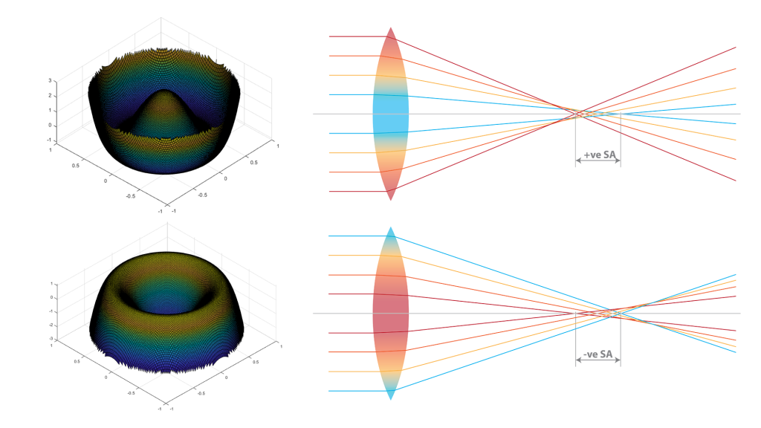
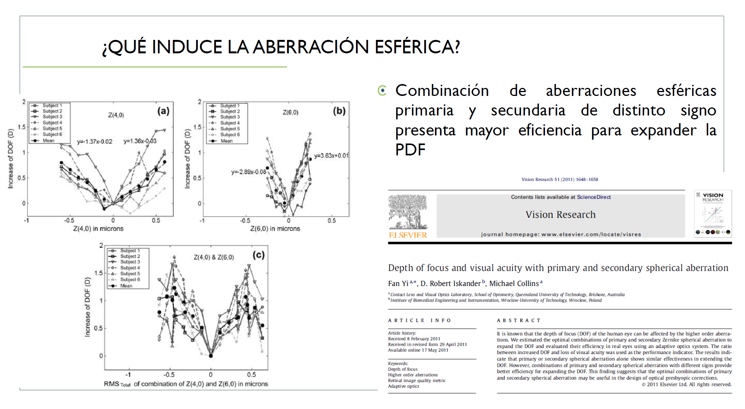
Depth of focus and astigmatism correction
Spherical Aberrations with Different Signs provide better efficiency to increase
the Depth of focus
Creating spherical aberration, it is possible to obtain multifocality

Slide 4
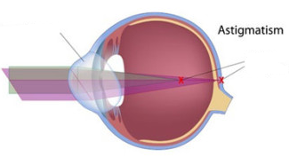
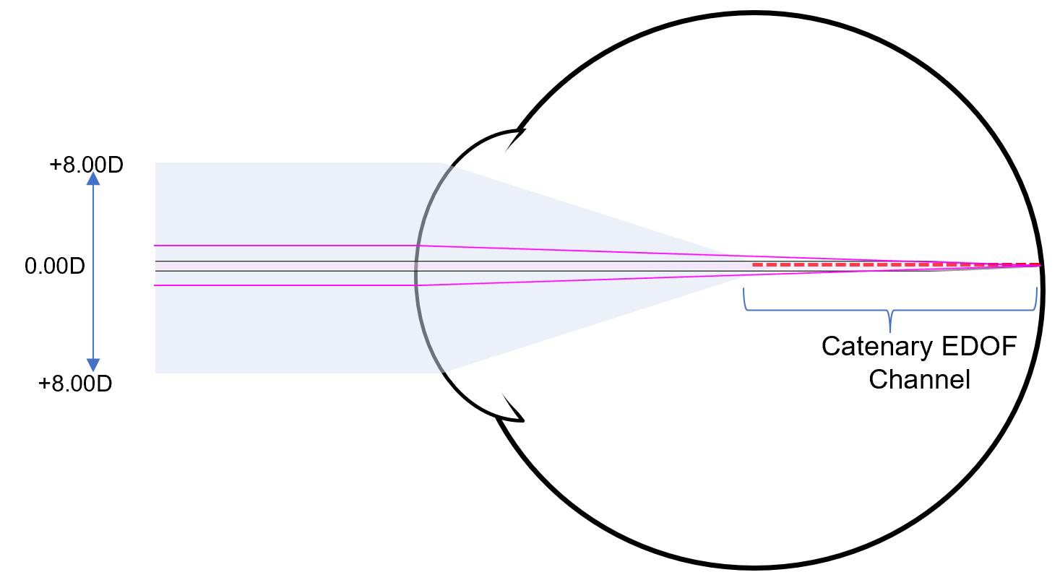
Depth of focus and astigmatism correction
Toric optic
Two focal points
The astigmatic eye has two focal points
EDOF channel can correct astigmatism (both meridians can be in focus at the same time) [The same way it corrects presbyopia]
Approved for up to 2.00 DC

Slide 5
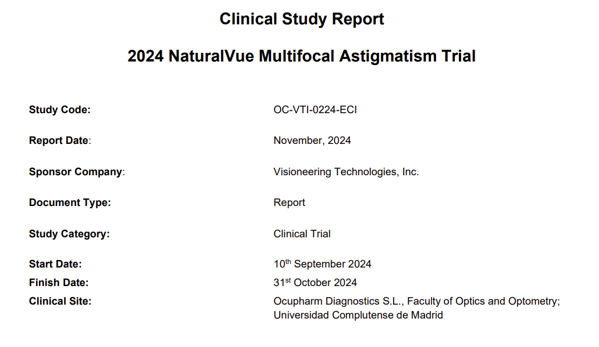

    Principal investigator
    Gonzalo Carracedo, PhD
    Researcher
    Ana Privado, PhD

Slide 6

Main Objective
Generate Scientific evidence and Clinical data to support
the NaturalVue Multifocal indication of astigmatism correction up to 2.00 DC

Slide 7
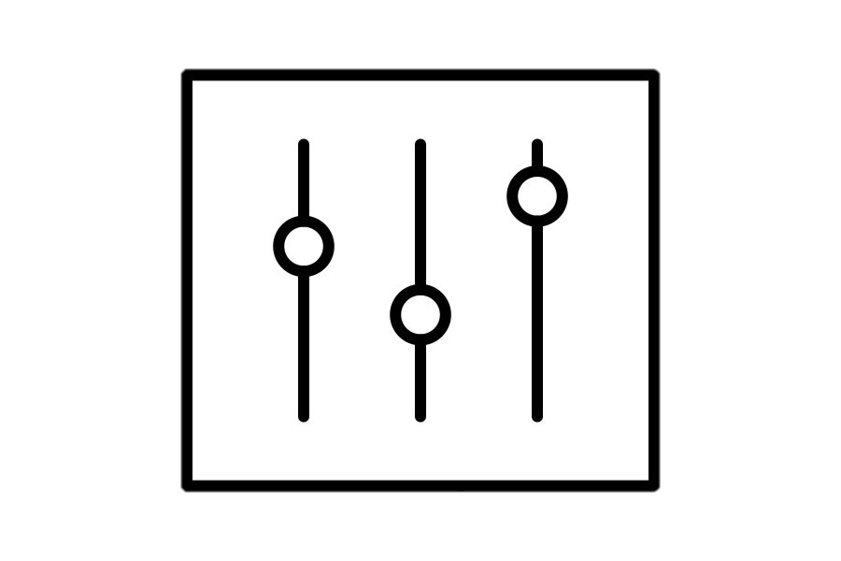

2. VISITS
Study design
V1: enrollment; screening; order.
V2: Lens fitting and dispense.
V3: 1d follow up.
V4: 1w follow up; study exit.
02
1. GROUPS
Divided in:
LA: Low Astigmatism
Between -0.75 and -1.25D
MA: Medium Astigmatism
From -1.50 to -2.00D
HA: High Astigmatism
Between 2.25 and -3.00D
01
3. PARAMETERS
High contrast distance binocular visual acuity (HCDBVA).
Stereopsis.
Subjective vision quality.
Subjective overall comfort.
03

Slide 8
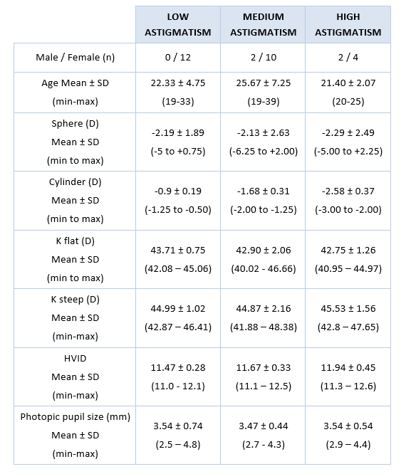
Patients

Slide 9
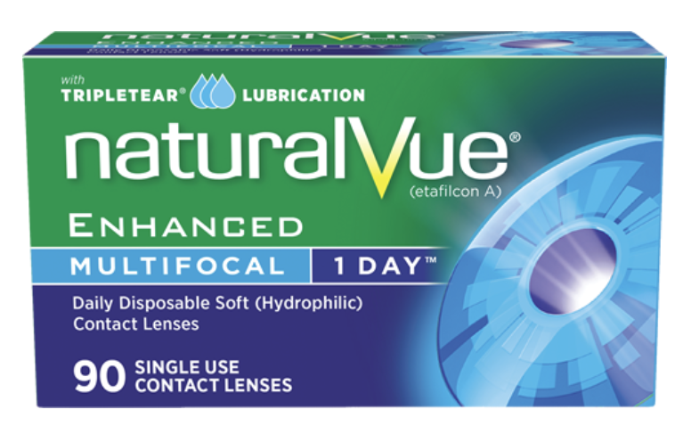
Lens parameters

Slide 10
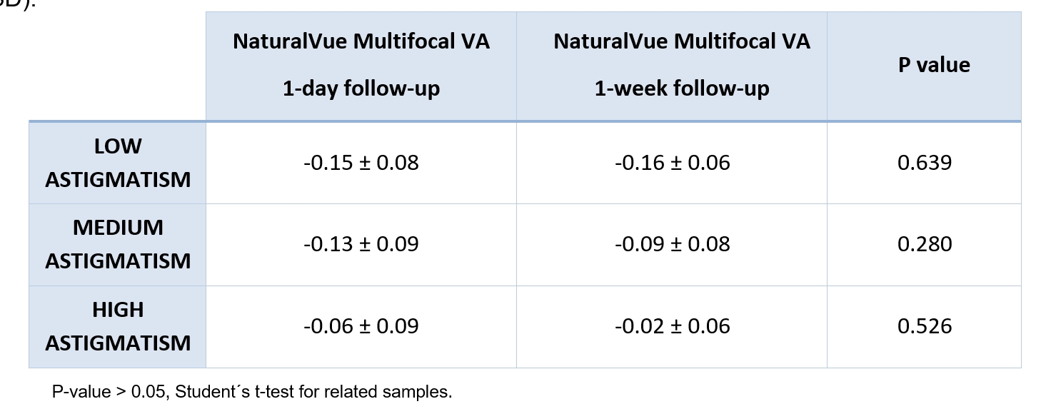
Binocular Distance Visual Acuity
W1 Binoc VA | (logMAR) | Avg±SD
-0.75 to -1.00 DC | n = 12 | -0.16 ± 0.06
20/20 or better | 100%
20/15 or better | 100%
-1.25 to -2.00 DC | n = 12 | -0.09 ± 0.08
20/20 or better | 100%
20/15 or better | 67%
-2.25 to -3.00 DC | n = 6 | -0.02 ± 0.06
20/20 or better | 83%
20/15 or better | 33%

Slide 11
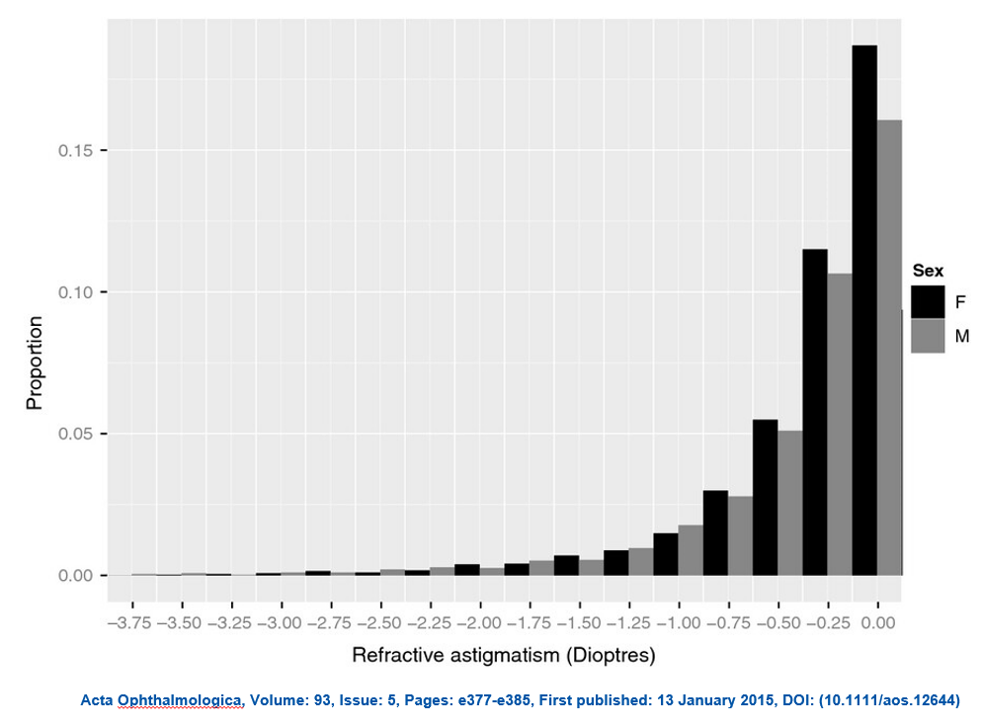
Binocular Distance Visual Acuity
3.00 DC
2.00 DC
W1 Binoc VA | (logMAR) | Avg±SD
-0.75 to -1.00 DC | n = 12 | -0.16 ± 0.06
20/20 or better | 100%
20/15 or better | 100%
-1.25 to -2.00 DC | n = 12 | -0.09 ± 0.08
20/20 or better | 100%
20/15 or better | 67%
-2.25 to -3.00 DC | n = 6 | -0.02 ± 0.06
20/20 or better | 83%
20/15 or better | 33%
100% 20/20
83% 20/20

Slide 12
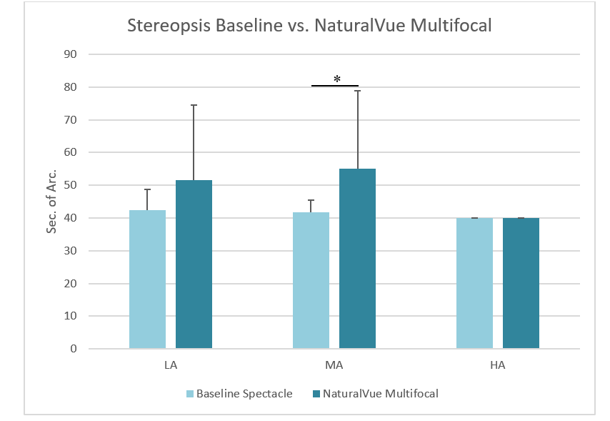
Stereopsis
Differences non-clinical relevant.
Stereopsis preserved.

Slide 13
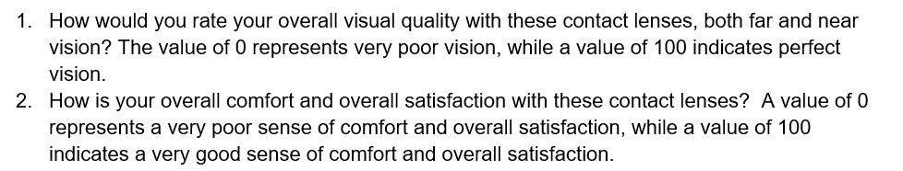
Visual Analogue Scale
Up to 49
Between 50 and 79
More than 80
Unsatisfactory
Satisfactory
Very satisfactory

Slide 14
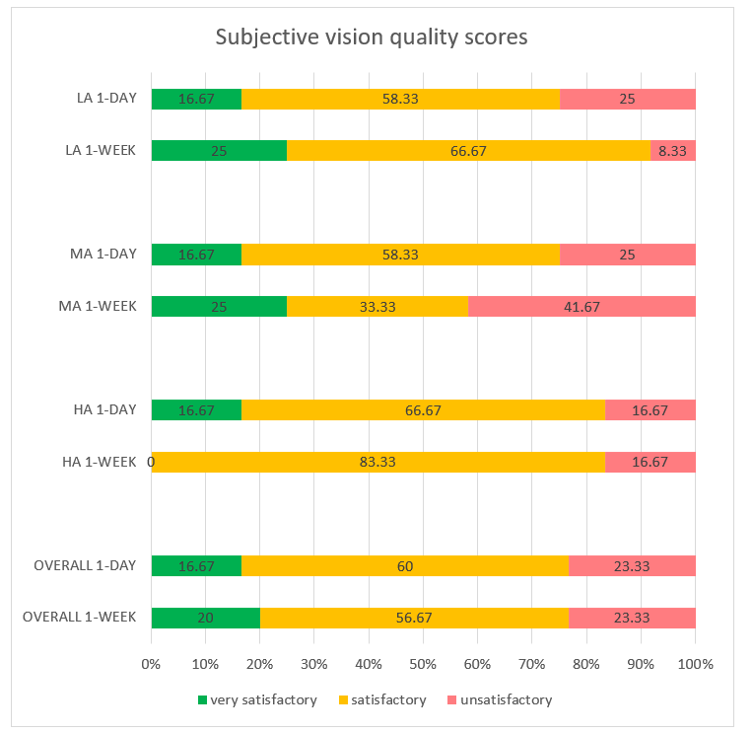
Subjective Vision Quality
High Vision Quality
in the 3 groups studied

Slide 15
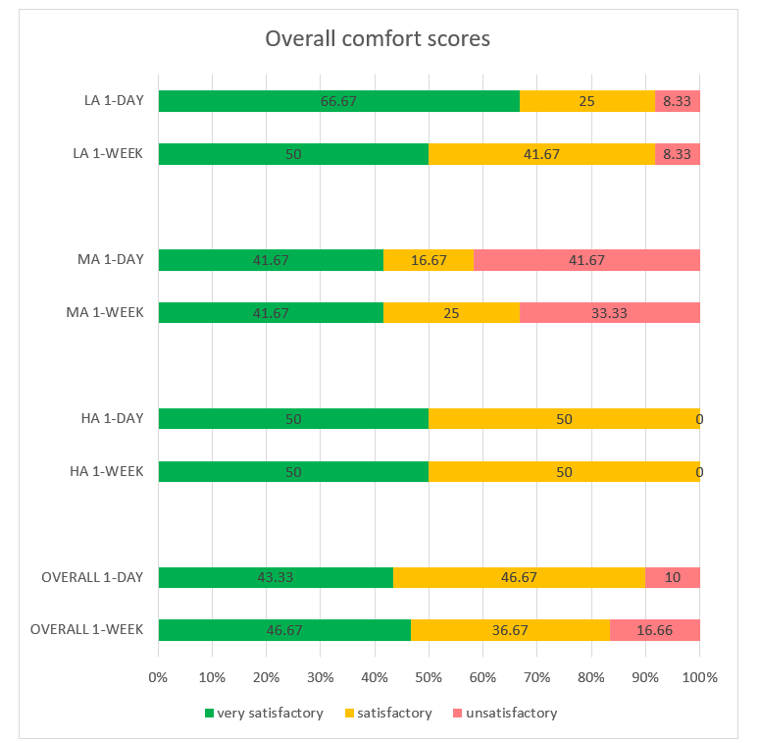
Subjective Overall Comfort
High Overall comfort
in the 3 groups studied

Slide 16
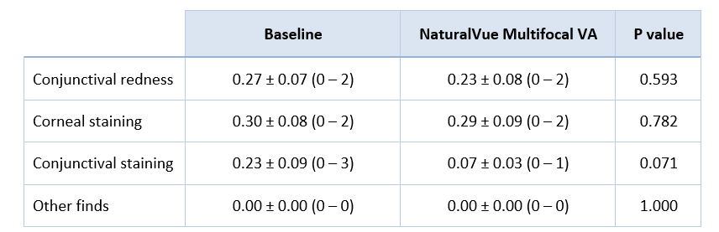
Adverse Events
No adverse events found.

Slide 17
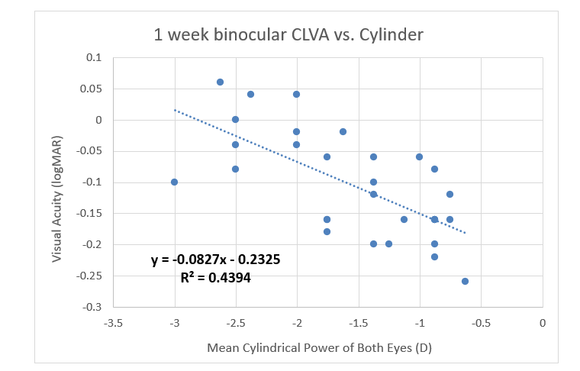
Predictors of Visual Acuity
    Among the range of vision, mild association with
    Magnitude of cylinder

Slide 18
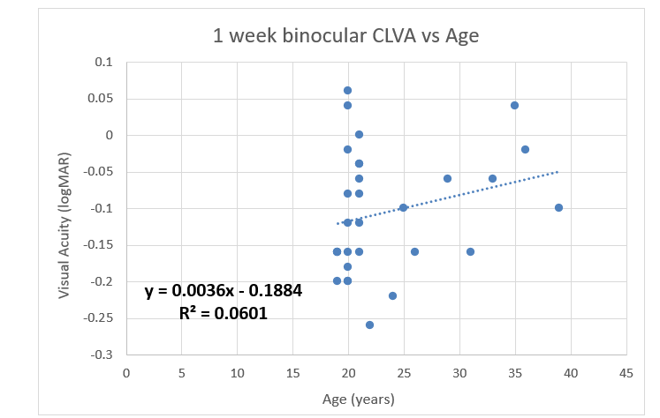
Predictors of Visual Acuity
    Age (older folks, >30, less likely to gain VA compared with BCVA)

Slide 19
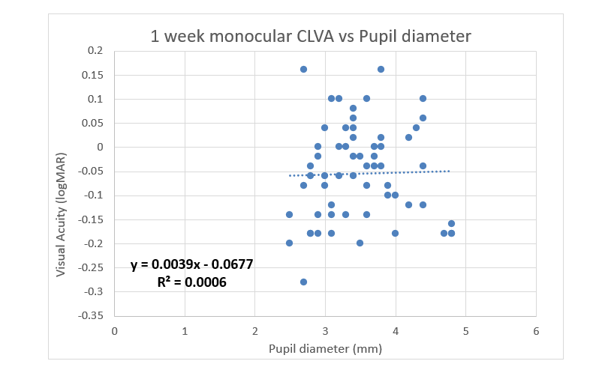
Predictors of Visual Acuity
    No correlation with pupil diameter

Slide 20
Summary
    The study demonstrated that NaturalVue® Enhanced Multifocal lenses effectively corrected (with 20/20 or better vision)
    77% rated their Overall Visual Quality as satisfactory or very satisfactory
    83% rated their Overall Comfort as satisfactory or very satisfactory
    Stereopsis preserved
    Works well with all pupil sizes
W1 Binoc VA | (logMAR) | Avg±SD
-0.75 to -1.00 DC | n = 12 | -0.16 ± 0.06
20/20 or better | 100%
20/15 or better | 100%
-1.25 to -2.00 DC | n = 12 | -0.09 ± 0.08
20/20 or better | 100%
20/15 or better | 67%
-2.25 to -3.00 DC | n = 6 | -0.02 ± 0.06
20/20 or better | 83%
20/15 or better | 33%

Slide 21
Conclusions
The study found that, unlike traditional toric optics, NaturalVue Multifocal corrects an extensive range of astigmatism by enabling both meridians to focus simultaneously.
This clinical trial validated the NaturalVue Multifocal lens’s astigmatism correction indication. Multifocal catenary curve-based contact lenses are a viable option for patients with astigmatism, and can potentially reduce additional chair time needed for toric soft contact lens fitting.
The lenses provided good visual performance and satisfaction patient feedback in vision and comfort, with no reported adverse events.

Slide 22

    jgcarrac@ucm.es

