Slide 1
A Catenary Curved Power Profile Contact Lenses for Myopia Management, Astigmatic Correction, and Presbyopia Correction
K. Ashley Tuan, OD, MS, PhD
Chief Medical Officer Visioneering Technologies, Inc.
MKT-VTI-CN6
Notes:
Total 60 mins, including questions
One optical design that can address multiple vision issues.

Slide 2

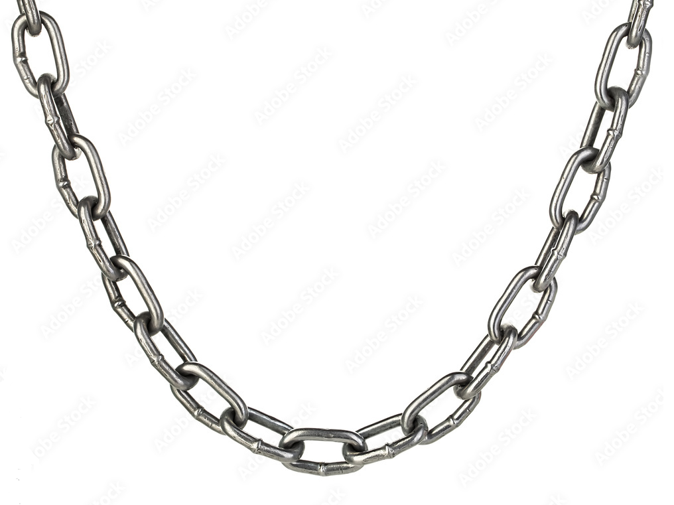
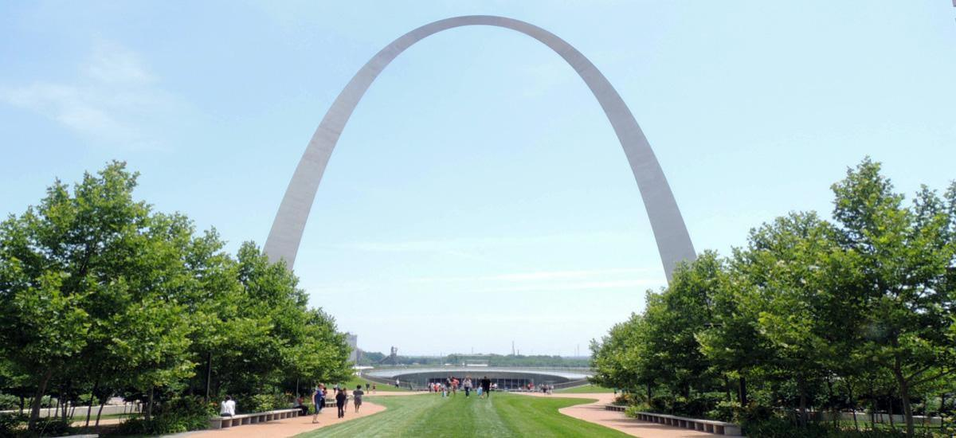
Catenary (Latin catēna = Chain)
MKT-RCT-CN5 r0
Notes:
NVMF is a Daily Disposable soft contact lens, using etafilcon A, which is a material that has a long-established safety profile.
NVMF is a center-distance lens, with a unique power profile, that rapidly and smoothly delivers 8 D of relative plus at 6mm.
This aspheric curve on steroids is in the shape called the Catenary curve.
This shape may look familiar to ortho-k fitters, who routinely play with optical zone size and Jenssen Factor to customize the lens based on patients' pupil sizes and cornea biomechanics to deliver enough spherical aberrations for effective myopia management.
Unlike ortho-k, this is a shape you can repeatedly and consistently deliver over and over to every patient.
@6mm: 8 D (children’s pupil, ambient light)
@5.5mm: 6 D (children’s pupil, ambient light)
@4mm: 2.75-3.00 D (Presbyopes’ pupil)

Slide 3
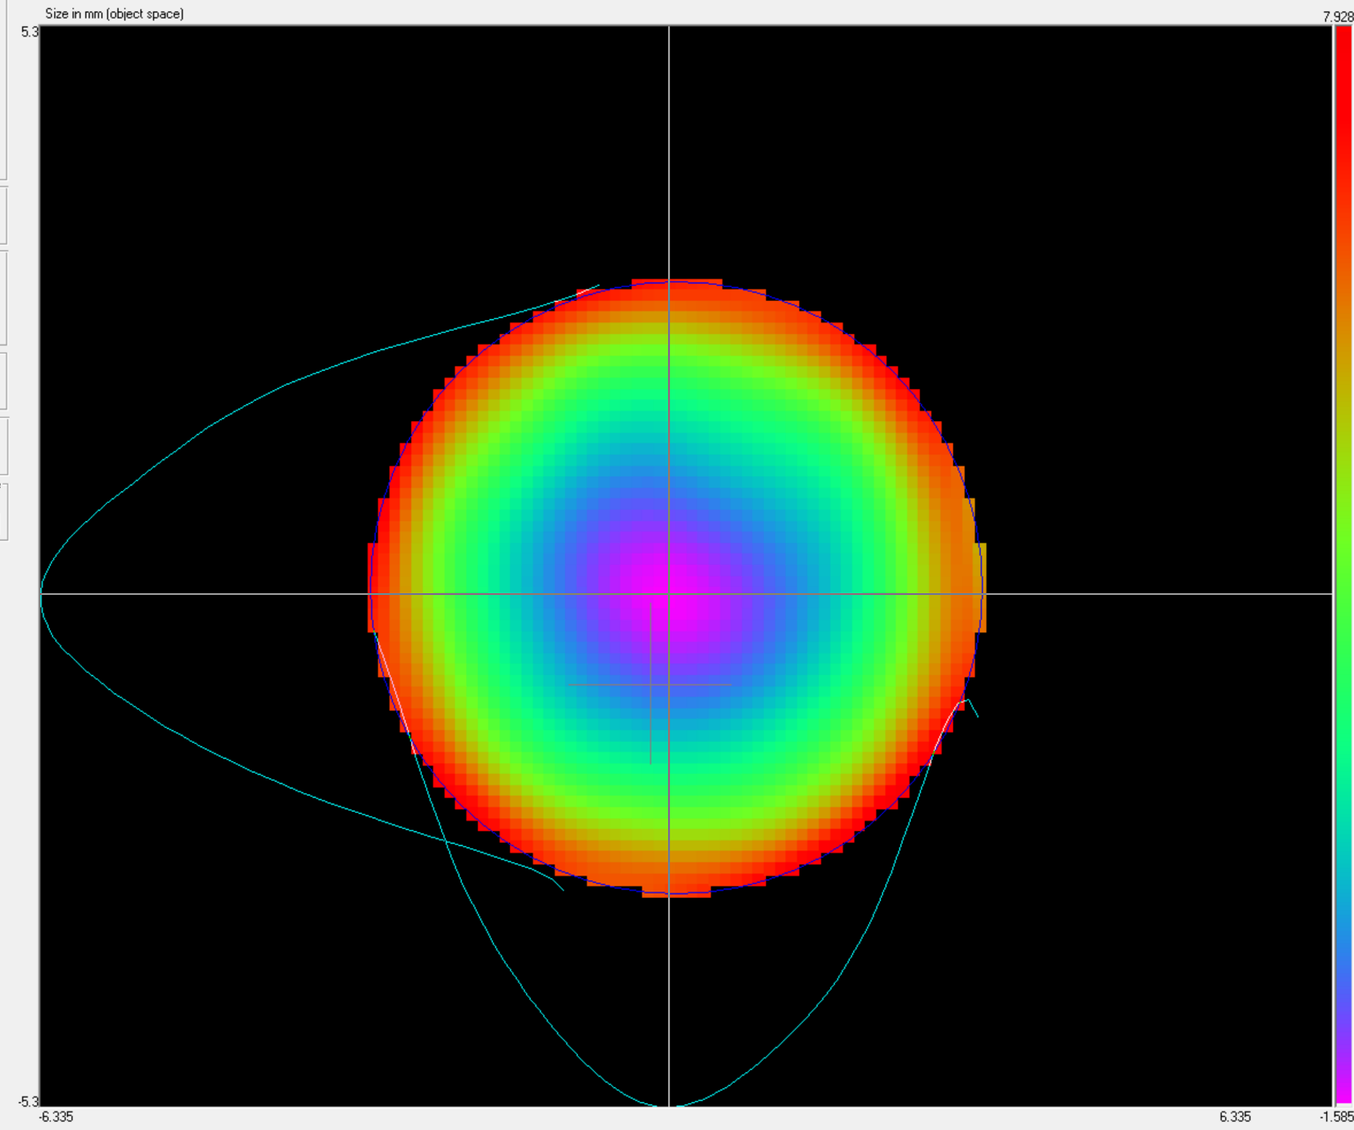
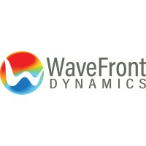
Catenary Power Profile Contact Lenses
+8.00 D at 6mm diameter
Relative Plus
Hartmann-Shack Aberrometer
Distance Rx
+8.00 µm Sph Aberration at 6mm diameter
MKT-RCT-CN5 r0
Notes:
NVMF is a Daily Disposable soft contact lens, using etafilcon A, which is a material that has a long-established safety profile.
NVMF is a center-distance lens, with a unique power profile, that rapidly and smoothly delivers 8 D of relative plus at 6mm.
This aspheric curve on steroids is in the shape called the Catenary curve.
This shape may look familiar to ortho-k fitters, who routinely play with optical zone size and Jenssen Factor to customize the lens based on patients' pupil sizes and cornea biomechanics to deliver enough spherical aberrations for effective myopia management.
Unlike ortho-k, this is a shape you can repeatedly and consistently deliver over and over to every patient.
@6mm: 8 D (children’s pupil, ambient light)
@5.5mm: 6 D (children’s pupil, ambient light)
@4mm: 2.75-3.00 D (Presbyopes’ pupil)

Slide 4
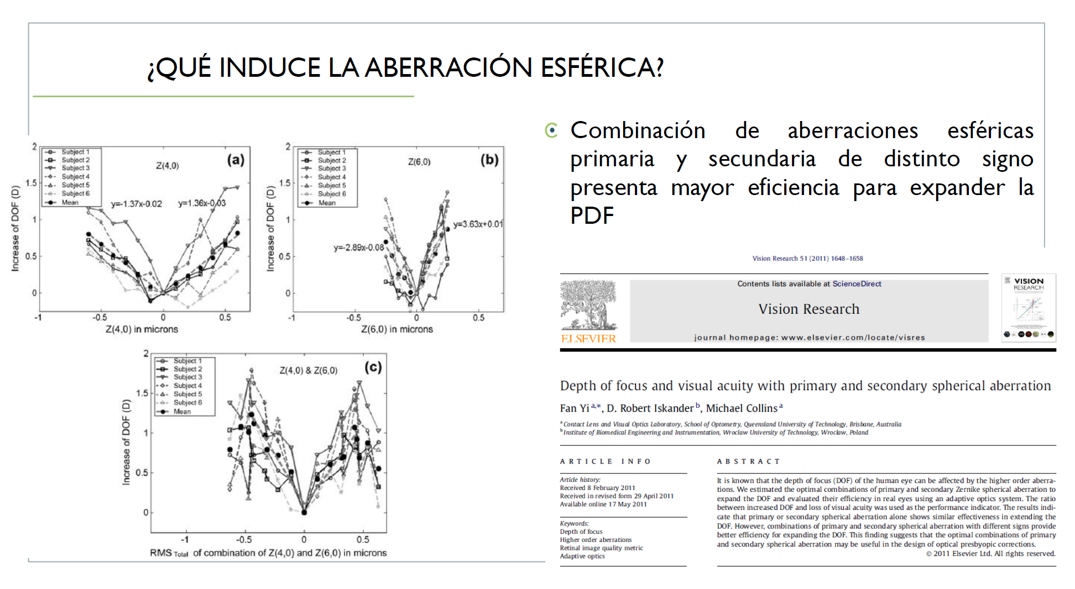
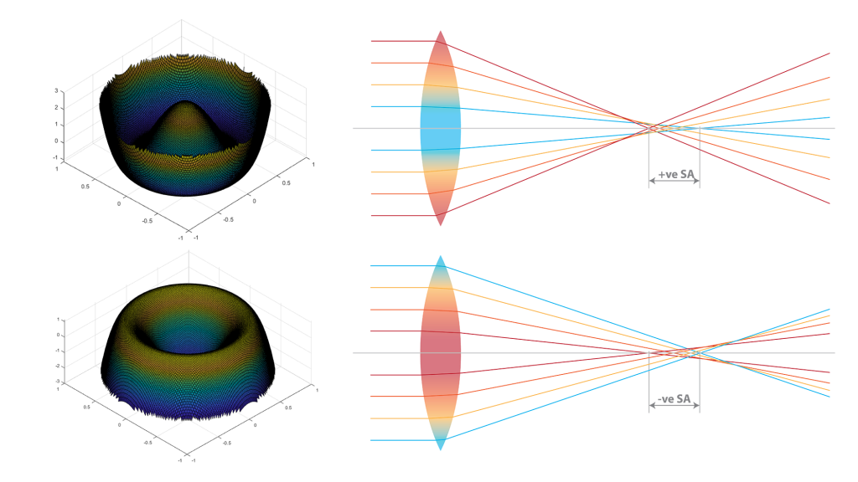
Spherical Aberration and Depth of Focus
Extended depth of focus = virtual pinhole
Notes:
It is all in the design!
NVMF’s asphericity can be described in spherical aberration, which is known to provide less impact on VA to extend the subject’s DOF.
Resulting in a virtual pinhole effect

Slide 5
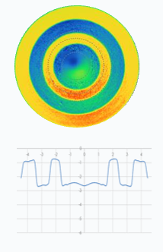
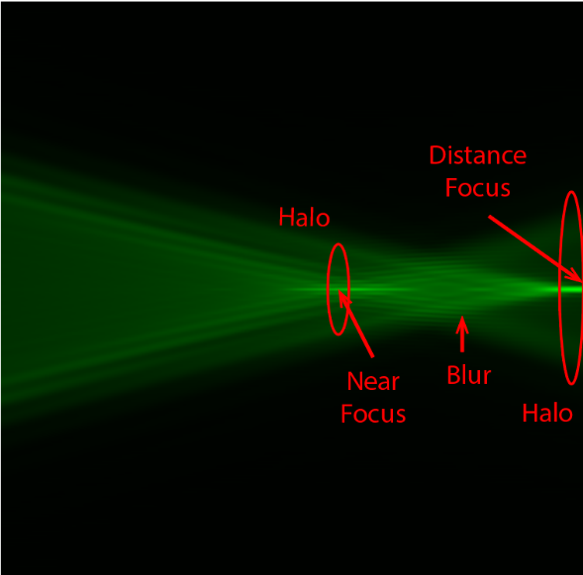
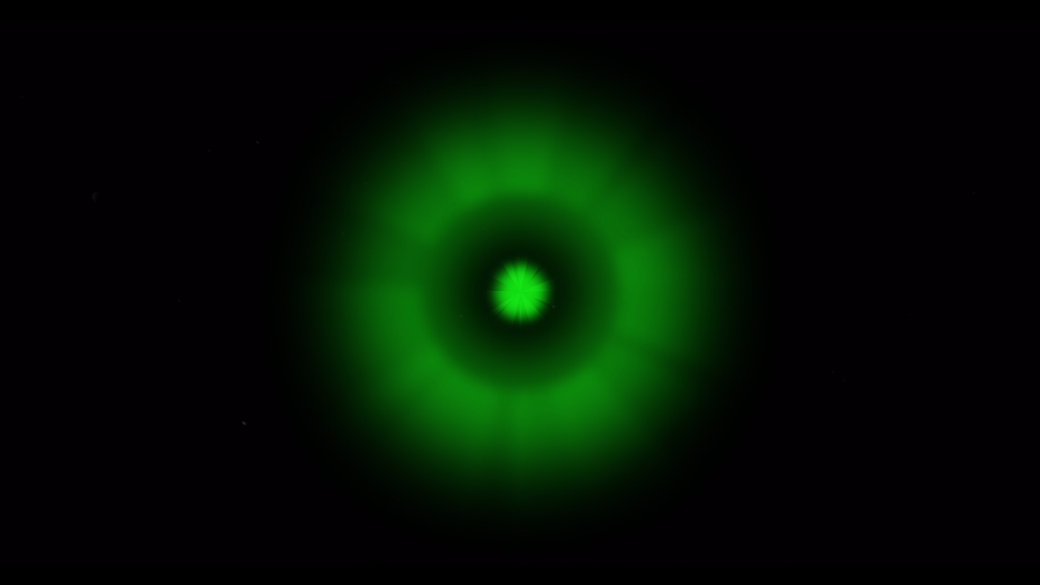
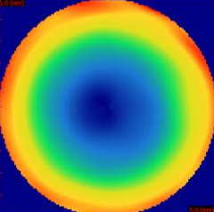
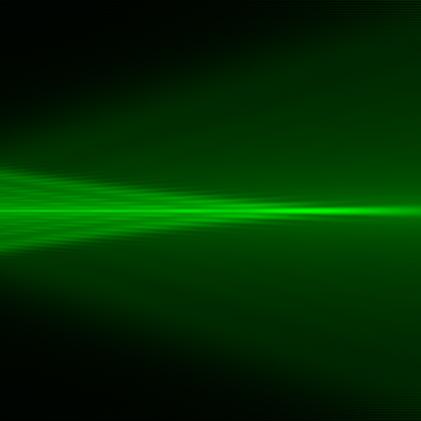
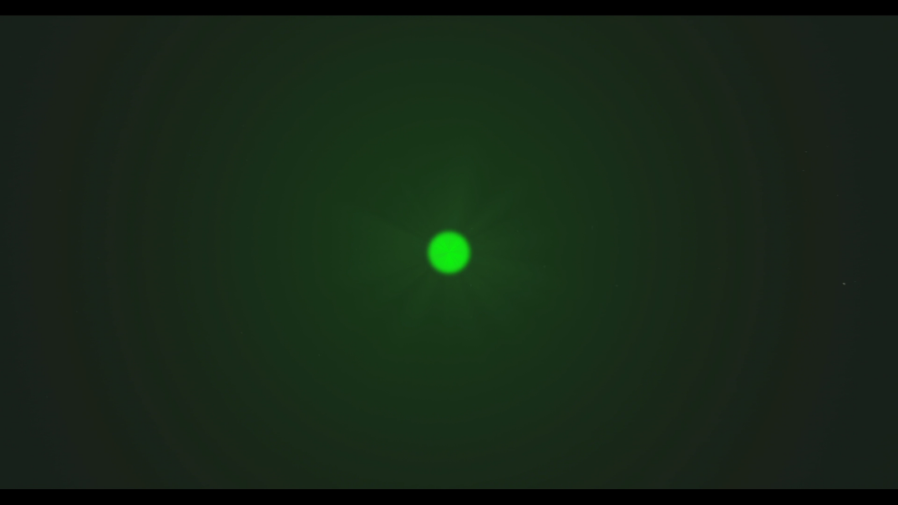
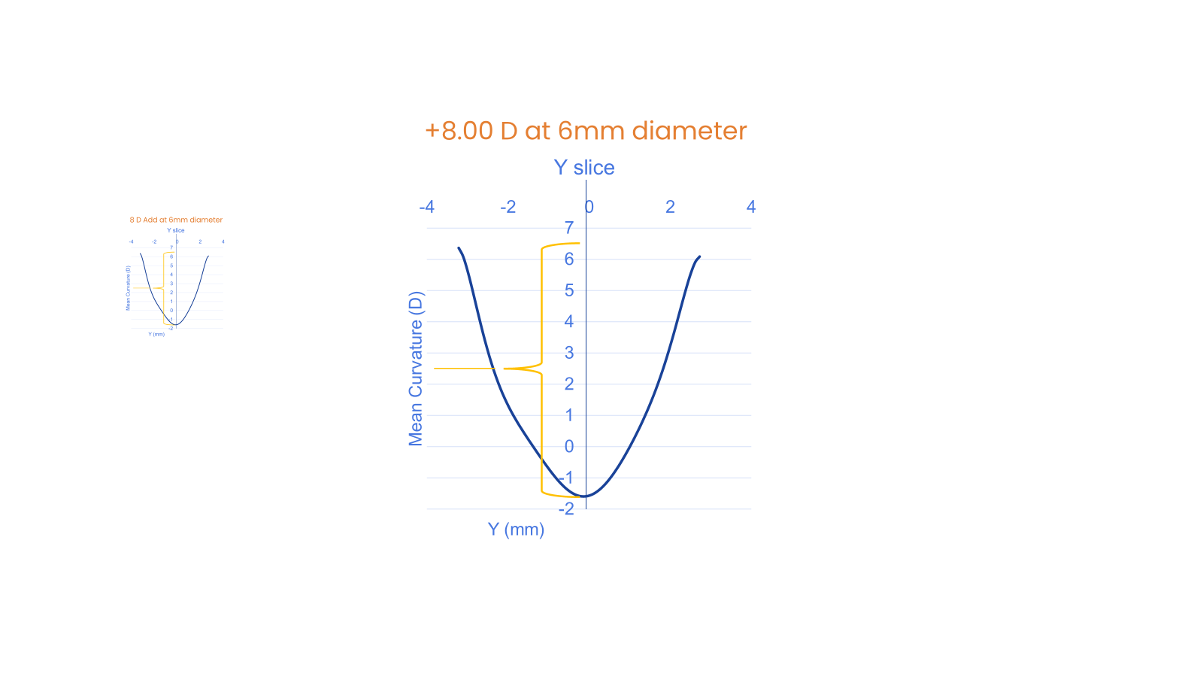
Not all Multifocality is the Same
Bifocal/Zonal Refractive optic
Halo and ghosting could be obvious
Defocus treatment area is limited
Catenary Multifocal
Halo evenly spread out, reduced intensity
Defocus treatment area significantly increased >±30°
EDOF Channel
Halo
MKT-MCC-CN3 M r1
5
Notes:
We have conducted Raytracing to look at the image quality of different lens design through a model eye
The defocus rays resulting from different lens designs, are great friend for controlling progressing myopes. However, how it is delivered can significantly impact the visual experience.
Bifocal optics results in defocused ray from the other focal point that can be concentrated in its distribution and creates hotspot
The Neurofocus Optics® technology applying a Catenary optics, generates an extremely high magnitude of myopic defocus but is smooth and gentle in intensity
The Neurofocus Optics® technology has a long and narrow EDOF channel which can reduce accommodative demand and address accommodative disfunctions.
The myopic defocus spreads out evenly to covers greater than ±30 degrees of retina thus the intensity per unit area has diluted. No hot spot. What the brain see is a vailing white noise. That can be filtered out easily. This is the foundation of Neurofocus optics.
The high magnitude of peripheral myopic defocus is enough to cancel out peripheral hyperopia for a wide range of the population and covers a wider retinal eccentricity.
(Compares to a 2 D SA, it covers over twice the diameter and less than quarter of its intensity. )

Slide 6
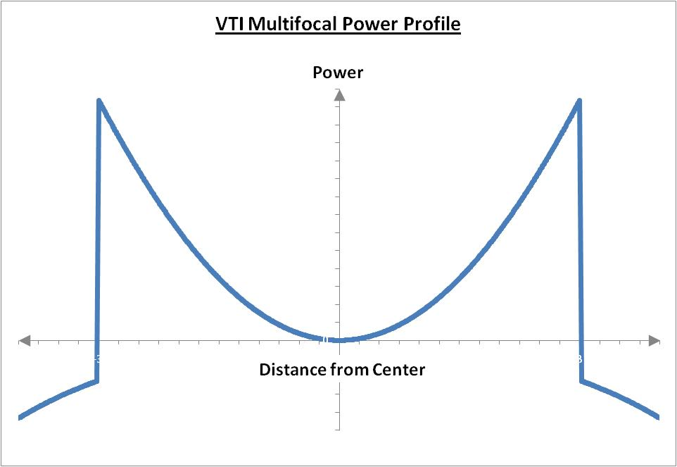
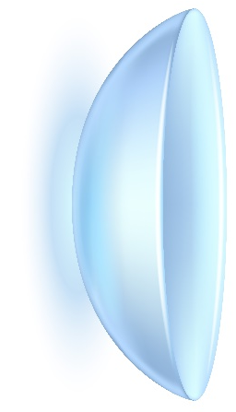
One Optical Design, Two Functions
Catenary power curve
Relative plus
High relative plus slows eye growth
+8 D
+8.00 D
0 D
Corrective power
EDOF Channel
for Presbyopes
0.00 D
+8 D
+8.00 D
This revolutionary optical design simultaneously provides:
Extended Depth of Focus (EDOF)
One Universal Add for all ages
One Universal Axis for astigmatism at least 2.00DC
Unprecedented magnitude of relative plus (myopic defocus)
Minimal image disturbance results in easy neuroadaptation
➔ spectacle level visual quality
➔ spectacle level stereopsis
MKT-MCC-CN3 M r1
Notes:
Neurofocus optics rapid and smooth power progression, causes minimal to no perception of visual disturbance, which allows an unprecedented amount of ADD power in the contact lens without sacrificing visual comfort.
This optic has two fascinating effects:
On-axis progressively changing focus distances generates a single, contiguous, elongated focal point, that extends the depth of focus of the eye, providing whatever presbyopic correction is needed.
Rays, after passing the focal points, will continue to diverge and create myopic defocus at the near peripheral retina, correcting hyperopic defocus, a risk factor that is believed to drive myopia progression.
While delivering these functions, the central optics correct the refractive error and preserve spectacle level high contrast acuity and stereopsis, which are critical for active lifestyles.

Slide 7
Extended Depth of Focus -Presbyopia
Notes:
Astigmatism is present in a large proportion of the population, and it needs to be addressed.

Slide 8
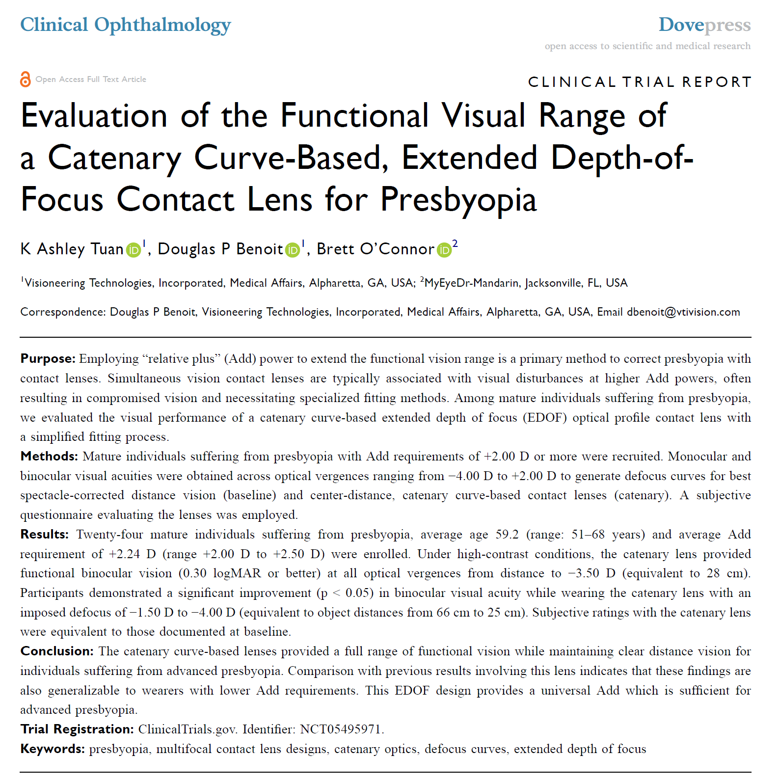
Extended Depth of Focus
Extended Depth of Focus (EDOF)
Performance quantified using the Defocus Curve
IOL EDOF lenses performance goal is to extend Defocus Curve by 2.00D
The Catenary Curve designed contact lenses meet that requirement on Mature Presbyopes
VTI-RCT-CN10 r0

Slide 9
Why do we need to look at Defocus Curve?
Traditional Presbyopic lens information doesn’t tell the full story
Why aren’t your patients satisfied?
What happens between two distances?
Multifocal lens performance
20/20
X
Visual Acuity
X
Distance
Near
VTI-RCT-CN10 r0

Slide 10
What is a Defocus Curve?
Think of the visual field’s Island of Vision (Traquiar’s hill of vision):
Non seeing area
Detection Sensitivity
Detection threshold
Seeing area
Under the sea: too low to be useful
Visual field extent
VTI-RCT-CN10 r0
Notes:
the higher the curve the better the vision…everything under the dotted line - under the “sea” too low to be useful

Slide 11

What is a Defocus Curve?
Functional Vision Threshold: 20/40 letter size equals to the small print on medicine bottles hold at 40cm, or the 7-point font size* on printed materials.
*I am in 7-point Arial font or 20/40 letter size if you hold me at 40cm
Defocus Curve presents the “Island of functional vision”
20/40
Functional seeing area
Functional seeing area
Bifocal IOL
Single Vision IOL
40 cm
VTI-RCT-CN10 r0
Notes:
Defocus curve demonstrates the functional vision that is achieved with a universal add
The higher the curve from the dotted line- the better the vision – use graph to highlight the height of the curve esp at intermediate distances (computer, driving, golf, tennis)

Slide 12
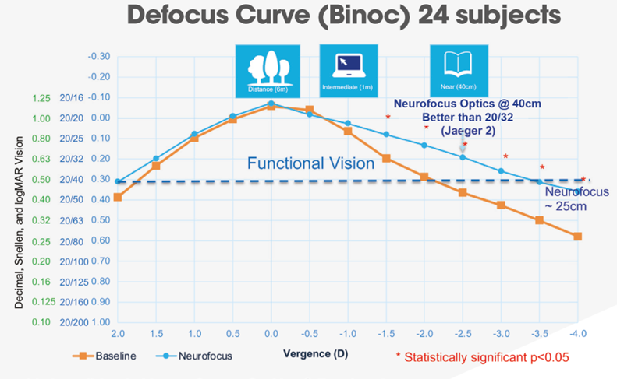
Catenary Curved Multifocal on Mature Presbyopes
Catenary curved multifocal improves intermediate and near vision without significant reduction in distance vision
VTI-RCT-CN10 r0
Notes:
We are evaluating the visual performance of NVMF using the standard the FDA use for EDOF IOLs, not comparing to other multifocals!
This standard is rigorous as, once an IOL is in there – it’s not coming out again readily!!

Slide 13
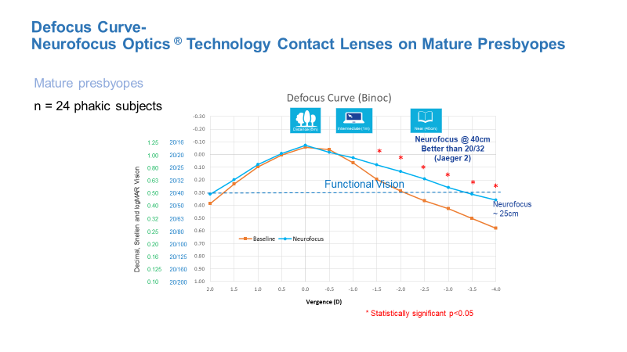
Catenary Curved Power Profile meets the definitions of Extended Depth of Focus¹
A true aspheric optic that has
a single, contiguous, elongated focal point that enhances depth of focus
extended functional vision demonstrated via Defocus Curve
Catenary curved power profile provides uninterrupted functional vision from Distance to 28cm²
Catenary curved power profile preserves spectacle level vision at distance, intermediate, and near, and preserves stereopsis³
40cm: Print on medicine bottles
28cm:
Street names on maps
1. Feldman B, Patel A, Masters JS, Koushik T, DelMonte DW, McMahon JF et al. Extended Depth of Focus IOLs. EyeWiki, American Academy of Ophthalmology, Mar 2023.
2. Tuan KA, Benoit DP, O’Connor B. Evaluation of the functional visual range of a catenary curve-based, extended depth-of-focus contact lens for presbyopia. Clin Ophthalmol. 2024;18:2113-2123. doi: 10.2147/OPTH.S468699
3. VTI data on file 2015. n=59. Data assessed after 1 week of wear. At p<0.05. No statistically significant differences were obtained between BCSV and NaturalVue® Multifocal 1 Day contact lenses.
VTI-RCT-CN10 r0
Notes:
24 mature presbyopes (>-2.00 D Add requirement, Avg +2.25 D)
Met FDA definition of EDOF (Functional Vision at 20/40), extended DOF by 2.00 D
Uninterrupted functional vision from Distance to 28 cm

Slide 14
Subjective Assessment Scale
Data includes subjects with astigmatism up to 1.50DC
0= extremely poor and 100= extremely good/no problems.
Mature presbyopes have similar scores from both studies
Early to mature presbyopes have similar scores
Study Cohort Add requirement | Overall Comfort | Distance Vision | Intermediate Vision | Near Vision | Overall Performance | Difficulty w/ Daily Visual Activities (Y/N) | % of Overall Daily Visual Needs Met w/ only this lens
Catenary Defocus Study ≥+2.00 (n=24) | 94.9 ±7.7 | 90.2 ±9.6 | 90.13 ±11.87 | 87.54 ±9.66 | 92.25 ±7.29 | 100% No Difficulty
PMET data (n=51) | 90.9 ±12.7 | 89.0 ±12.4 | 89.73 ±11.66 | 83.10 ±16.18 | 84.41 ±14.27 |  | 90.47 ±8.34
≥+2.00 (n=26) | 92.7 ±9.9 | 92.6 ±8.87 | 90.42 ±10.62 | 82.58 ±14.53 | 84.69 ±15.25 |  | 92.69 ±9.10
+1.50 to +1.75 (n=16) | 89.9 ±15.2 | 86.7 ±11.2 | 90.75 ±12.23 | 79.81* ±20.64 | 84.69 ±12.58 |  | 89.88 ±7.63
+1.00 to +1.25 (n=9) | 87.8 ±15.6 | 82.78±19.7 | 85.89 ±14.04 | 90.44* ±9.71 | 83.11 ±15.72 |  | 87.78 ±8.08
*Statistically different (p<0.05) from the other sub-groups.
VTI-RCT-CN10 r0
Notes:
Study also showed:
Participants reported high satisfaction with the lens performance
and comfort
No difficulty carrying out daily visual activities
NVMF’s defocus curve applies to all ages (=Universal ADD)
Data included patients with astigmatism as high as -1.50 DC

Slide 15
The Clinical Impact of Presbyopia Correction
Catenary curved multifocal improves intermediate and near vision without significant reduction in distance vision, which can serve as a Universal Add (for early to mature presbyopes)
Benefits of Universal Add Design
Ease of fitting – fit like a sphere
Saves chair time – no ‘adjusting add power and tweaking powers as presbyopia advances’
VTI-RCT-CN10 r0
Notes:
Patient retention – 92% repurchase rate

Slide 16
Extended Depth of Focus -Astigmatism
Notes:
Astigmatism is present in a large proportion of the population, and it needs to be addressed.

Slide 17
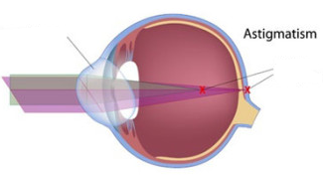
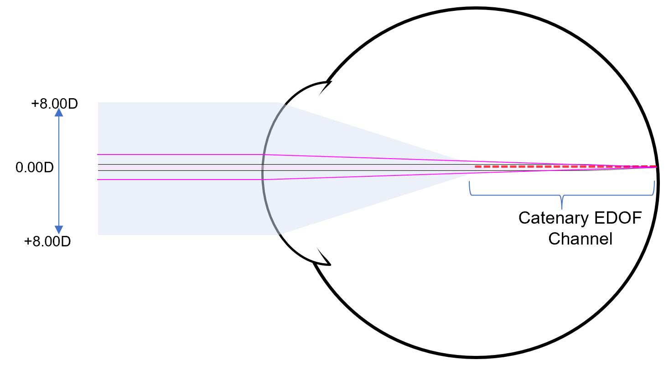
Catenary Power Profile’s EDOF Addresses Astigmatism
Toric optic
Two focal points
Fixed toric power and orientation
Universal power and rotational symmetry
The astigmatic eye has two focal points
EDOF channel can correct astigmatism (both meridians can be in focus at the same time) [The same way it corrects presbyopia]
VTI-RCT-CN10 r0
Notes:
Patient retention – 92% repurchase rate

Slide 18

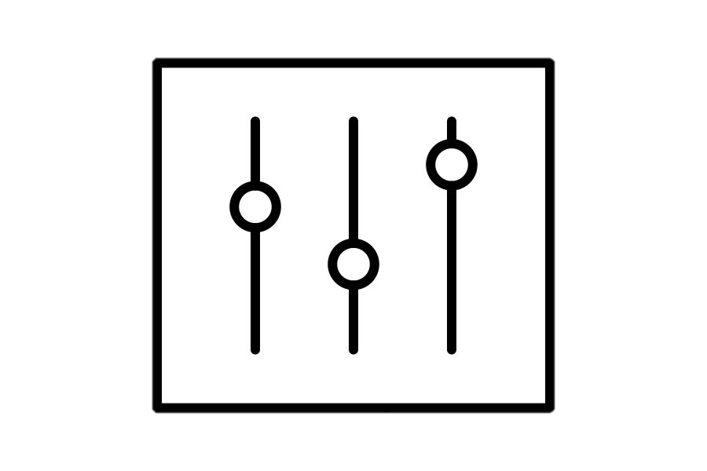

2. VISITS
V1: enrollment; screening; order.
V2: Lens fitting and dispense.
V3: 1d follow up.
V4: 1w follow up; study exit.
Study design
Principal investigator: Gonzalo Carracedo, PhD
Researcher: Ana Privado, PhD
02
GROUPS
LA: Low Astigmatism
Between -0.75 and -1.25D
MA: Medium Astigmatism
From -1.50 to -2.00D
HA: High Astigmatism
Between 2.25 and -3.00D
01
3. PARAMETERS
High contrast distance binocular visual acuity (HCDBVA).
Stereopsis.
Subjective vision quality.
Subjective overall comfort.
03
MKT-VTI-CN5
Notes:
Subjects divided into Low, medium and high astigmatism groups.
Binocular visual acuity, stereopsis and subject reported visual quality and comfort were collected.

Slide 19

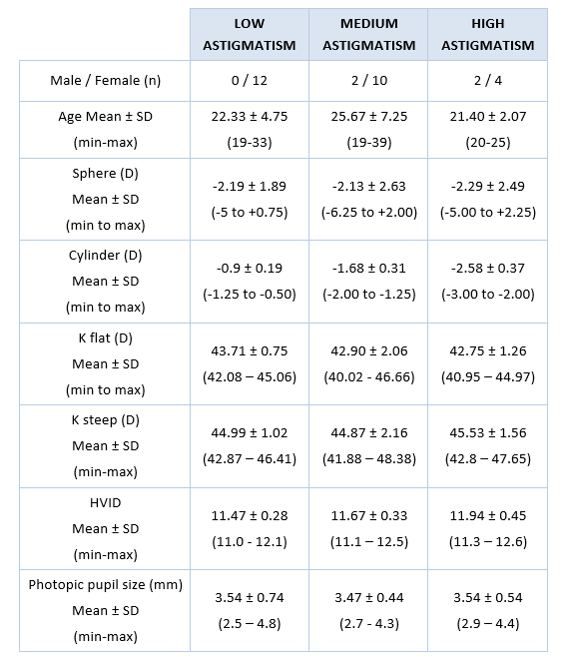
Binocular Distance Visual Acuity with NVEMF
No clinically or statistically meaningful change from the baseline (spectacle correction)
W1 Binoc VA | (logMAR) | Avg±SD
-0.75 to -1.00 DC | n = 12 | -0.16 ± 0.06
20/20 or better | 100%
20/15 or better | 100%
-1.25 to -2.00 DC | n = 12 | -0.09 ± 0.08
20/20 or better | 100%
20/15 or better | 67%
-2.25 to -3.00 DC | n = 6 | -0.06 ± 0.07
20/20 or better | 100%
20/15 or better | 33%
MKT-VTI-CN5

Slide 20

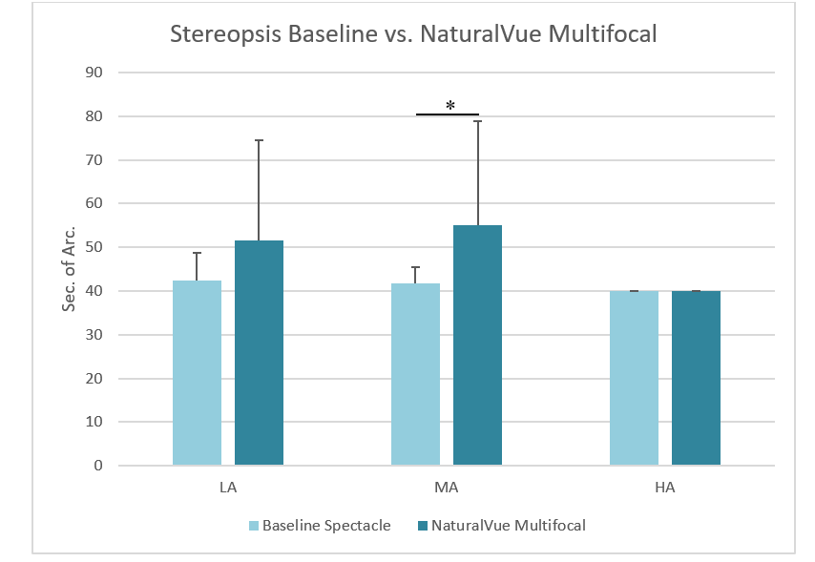
Stereopsis
Differences non-clinical relevant.
Stereopsis preserved.
MKT-VTI-CN5

Slide 21
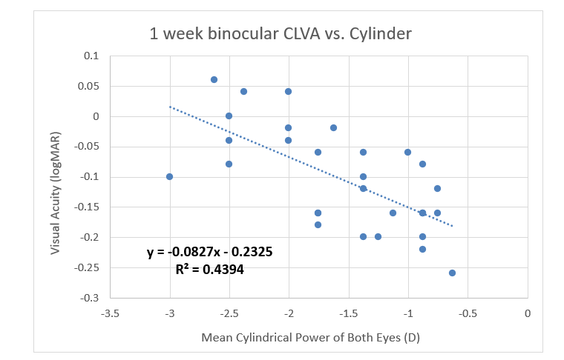
Predictors of Visual Acuity
Magnitude of cylinder
No associated with cylinder axis
No correlation with pupil diameter
MKT-VTI-CN5

Slide 22
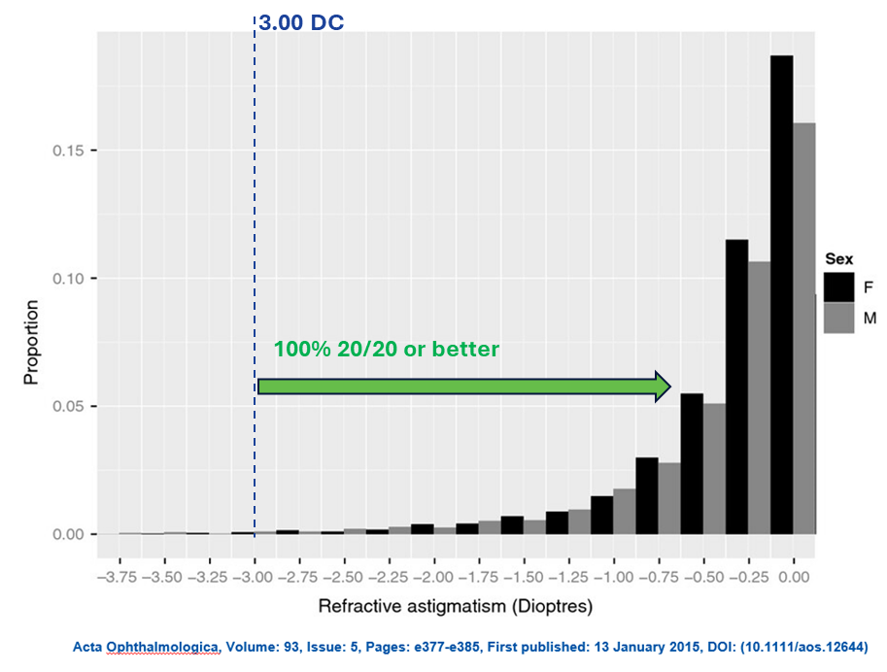
Key Outcomes
May provide 20/20 or better Binocular Distance VA up to 3.00DC >90% of population
Average 1.1 lens to success (20/20)
Important to follow the lens Fitting Guide; Bias towards minus
MKT-VTI-CN5

Slide 23
Visual Analogue Scale
1. How would you rate your overall visual quality with these contact lenses, both far and near vision?
77% rated their Overall Visual Quality as satisfactory or very satisfactory
2. How is your overall comfort and satisfaction with these contact lenses?
0= very poor, 100=perfect/very satisfactory
83% rated their Overall Comfort as satisfactory or very satisfactory
Up to 49
Between 50 and 79
More than 80
Unsatisfactory
Satisfactory
Very satisfactory
MKT-VTI-CN5

Slide 24
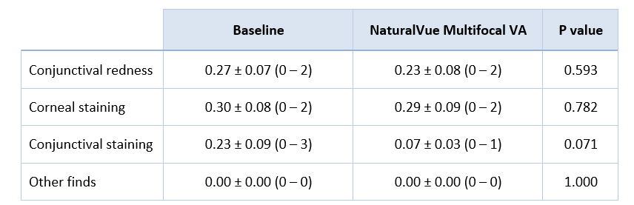
Adverse Events
No adverse events
Normal ocular findings
MKT-VTI-CN5

Slide 25
Astigmatism Correction Summary
Universal astigmatism power and universal axis
The study demonstrated that the catenary curved power profile lenses effectively corrected (with 20/20 or better vision)
100% of astigmatism up to 3.00DC
May cover over 90% of the general public’s refractive needs
Stereopsis preserved
Works well with all pupil sizes
Clinical Impact:
Fit like a single-vision lens
Great Daily Disposable option for Myopia Management and Presbyopia Correction
MKT-VTI-CN5
Notes:
The study found that, unlike traditional toric optics, NaturalVue Multifocal corrects an extensive range of astigmatism by enabling both meridians to focus simultaneously.
This clinical trial validated the NaturalVue Multifocal lens’s astigmatism correction indication. Multifocal catenary curve-based contact lenses are a viable option for patients with astigmatism, and can potentially reduce additional chair time needed for toric soft contact lens fitting.
The lenses provided good visual performance and satisfaction patient feedback in vision and comfort, with no reported adverse events.

Slide 26
Myopic Defocus -Myopia Management
Notes:
Astigmatism is present in a large proportion of the population, and it needs to be addressed.

Slide 27
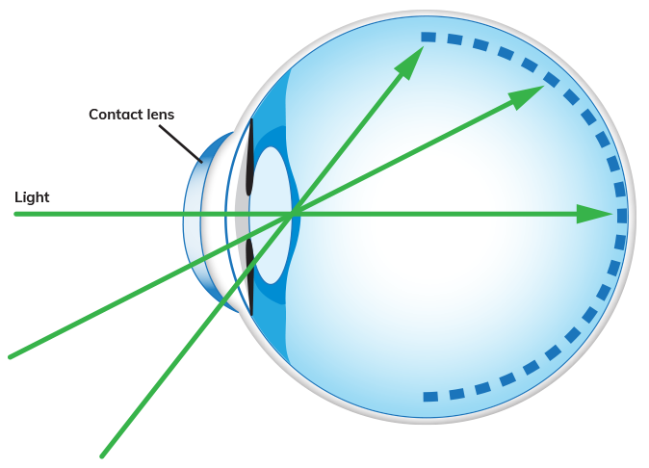
Optical Defocus for Myopia Management
Factors That Matter
Magnitude: Relative plus (myopic defocus) dependent
Location: Eccentricity dependent
Duration: Wearing time
MKT-NVEM-CE2 r0
Notes:
Optical defocus is a known mode of action for myopia control
Decades of research concluded that the treatment efficacy is based on three factors
-First, the dosage matters. That means the magnitude of the relative plus (myopic defocus) is important.

Slide 28
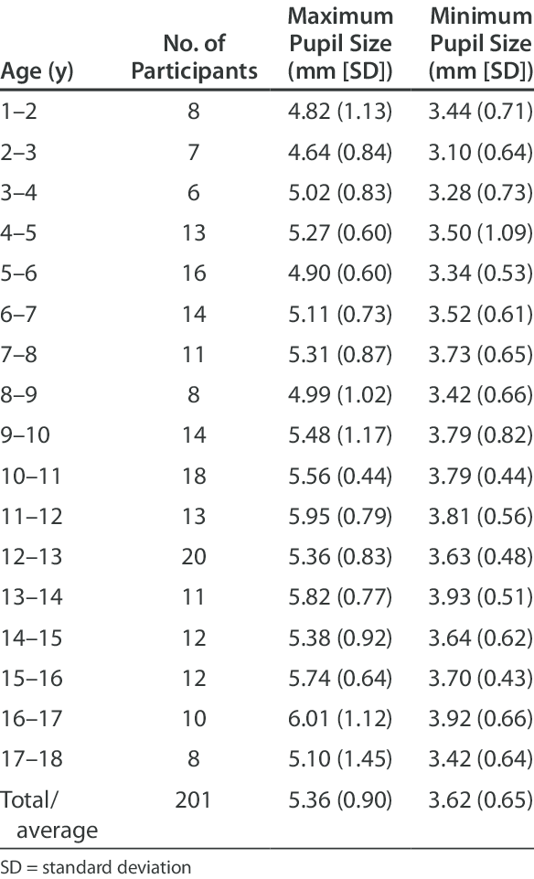
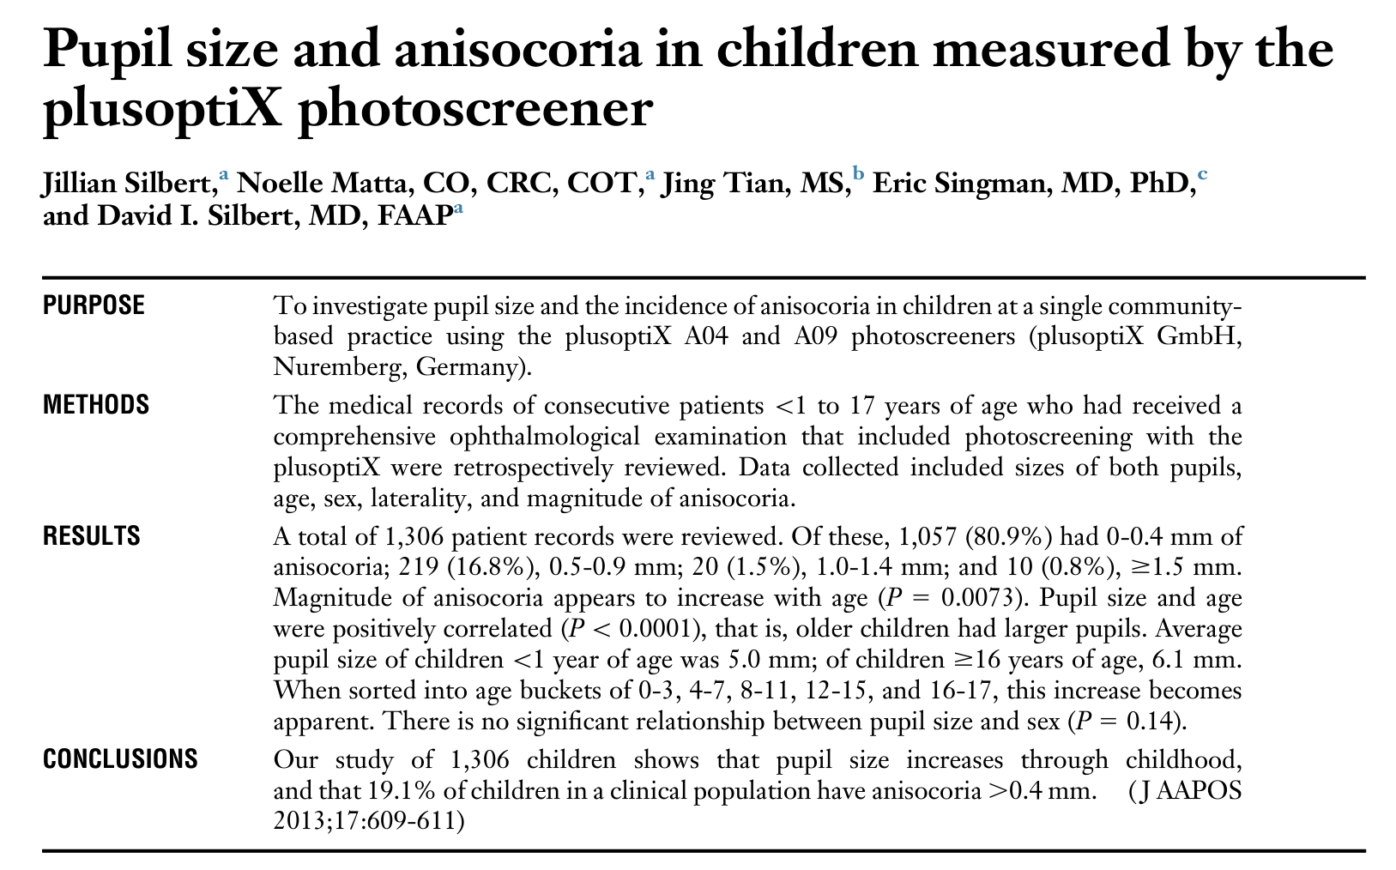
Pupil Sizes in Children
Average pupil size in children is ~ 5.5-6mm^{1,2}
1
2
plusoptiX Photoscreener
Ambient light condition
N=1,306
NeurOptics Pupillometer
Ambient light condition
N=272
Connelly M, Neville K. Developmental Changes of Normal Pupil Size and Reactivity in Children. J Ped Ophthal Strab, May 2015. DOI:10.3928/01913913-20150317-11
Silbert et al. Pupil size and anisocoria in children measured by the plusoptiX photo screener. JAAPOS 2013;17:609-611
MKT-NVEM-CE2 r0
Notes:
When selecting the MPC lenses for children, we should take their pupil size into consideration.
PROTECT: 5.7mm

Slide 29
Catenary Power Profile Contact Lenses
+8.00 D at 6mm diameter
Relative Plus
Hartmann-Shack Aberrometer
Distance Rx
+8.00 µm Sph Aberration at 6mm diameter
MKT-RCT-CN5 r0
Notes:
NVMF is a Daily Disposable soft contact lens, using etafilcon A, which is a material that has a long-established safety profile.
NVMF is a center-distance lens, with a unique power profile, that rapidly and smoothly delivers 8 D of relative plus at 6mm.
This aspheric curve on steroids is in the shape called the Catenary curve.
This shape may look familiar to ortho-k fitters, who routinely play with optical zone size and Jenssen Factor to customize the lens based on patients' pupil sizes and cornea biomechanics to deliver enough spherical aberrations for effective myopia management.
Unlike ortho-k, this is a shape you can repeatedly and consistently deliver over and over to every patient.
@6mm: 8 D (children’s pupil, ambient light)
@5.5mm: 6 D (children’s pupil, ambient light)
@4mm: 2.75-3.00 D (Presbyopes’ pupil)

Slide 30
Optical Defocus for Myopia Management
Factors That Matter
Magnitude: Relative plus (myopic defocus) dependent
Location: Eccentricity dependent
Duration: Wearing time
MKT-NVEM-CE2 r0
Notes:
Decades of research also concluded that -
The retinal location where the relative plus falls and the total area of the retina exposure matters. There is an eccentricity dependency.

Slide 31
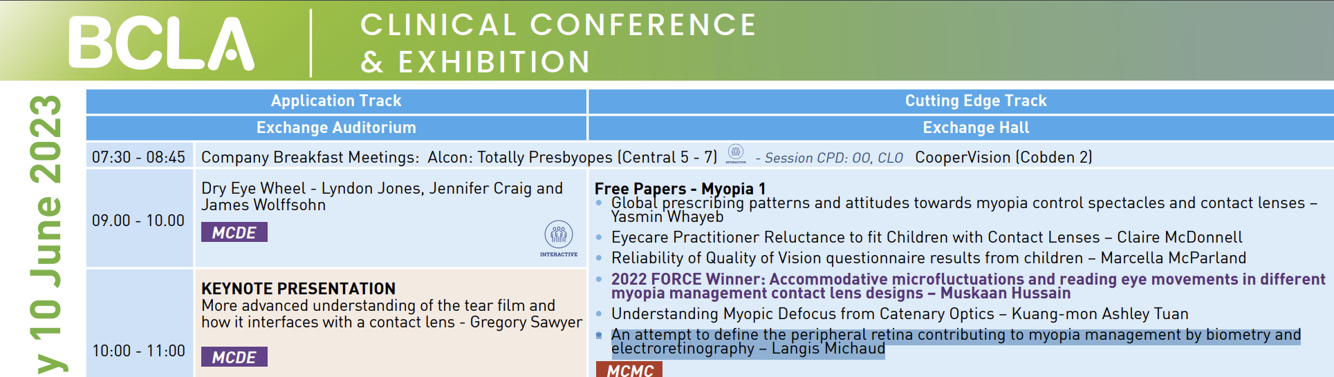
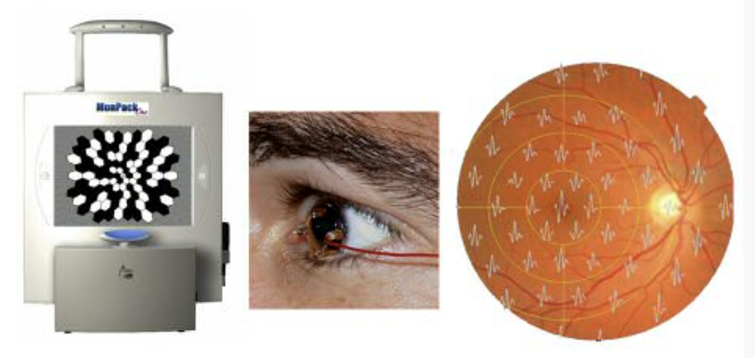
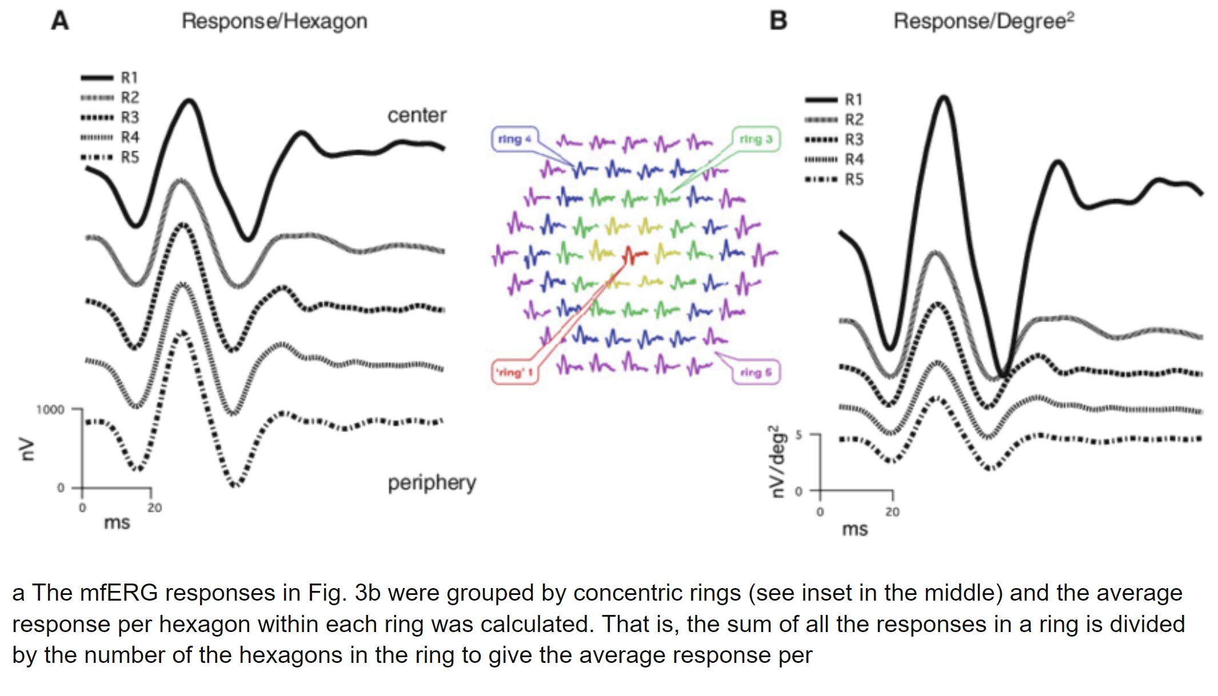
Retinal Location - Human Study
Langis Michaud 2023 (BCLA)
Retinal response to myopic defocus through electroretinography (mfERG)
N=27
MF SCL of different optical zone diameters (myopic defocus has different coverage on the retina)
Significant reduction of the induced wave when having larger defocus retinal coverage
Significant ERG amplitude difference only detected at a retinal eccentricity of the 5th Ring (15.7° to 24°)
“This implies that this area is likely the most sensitive to myopic defocus.”
MKT-RCT-CN5 r0
Notes:
Prof. Langis Michaud from Université de Montréal shared his research findings at BCLA in 2023. Subsequently, Boily, Michaud, and colleagues published this data in Eye & Contact Lens (July 2024).
Using multifocal ERG to look at the retinal response to myopic defocus.
He measured 27 subjects wearing two different multifocal soft contact lens designs. One design provides a larger area of relative plus.
He found with larger defocus coverage, a reduced retinal response was detected, but only at the most outer ring.
That translates to around15-24 degrees.
He then concluded their result implies 15-24 degrees of eccentricity is the most sensitive to myopic defocus.

Slide 32
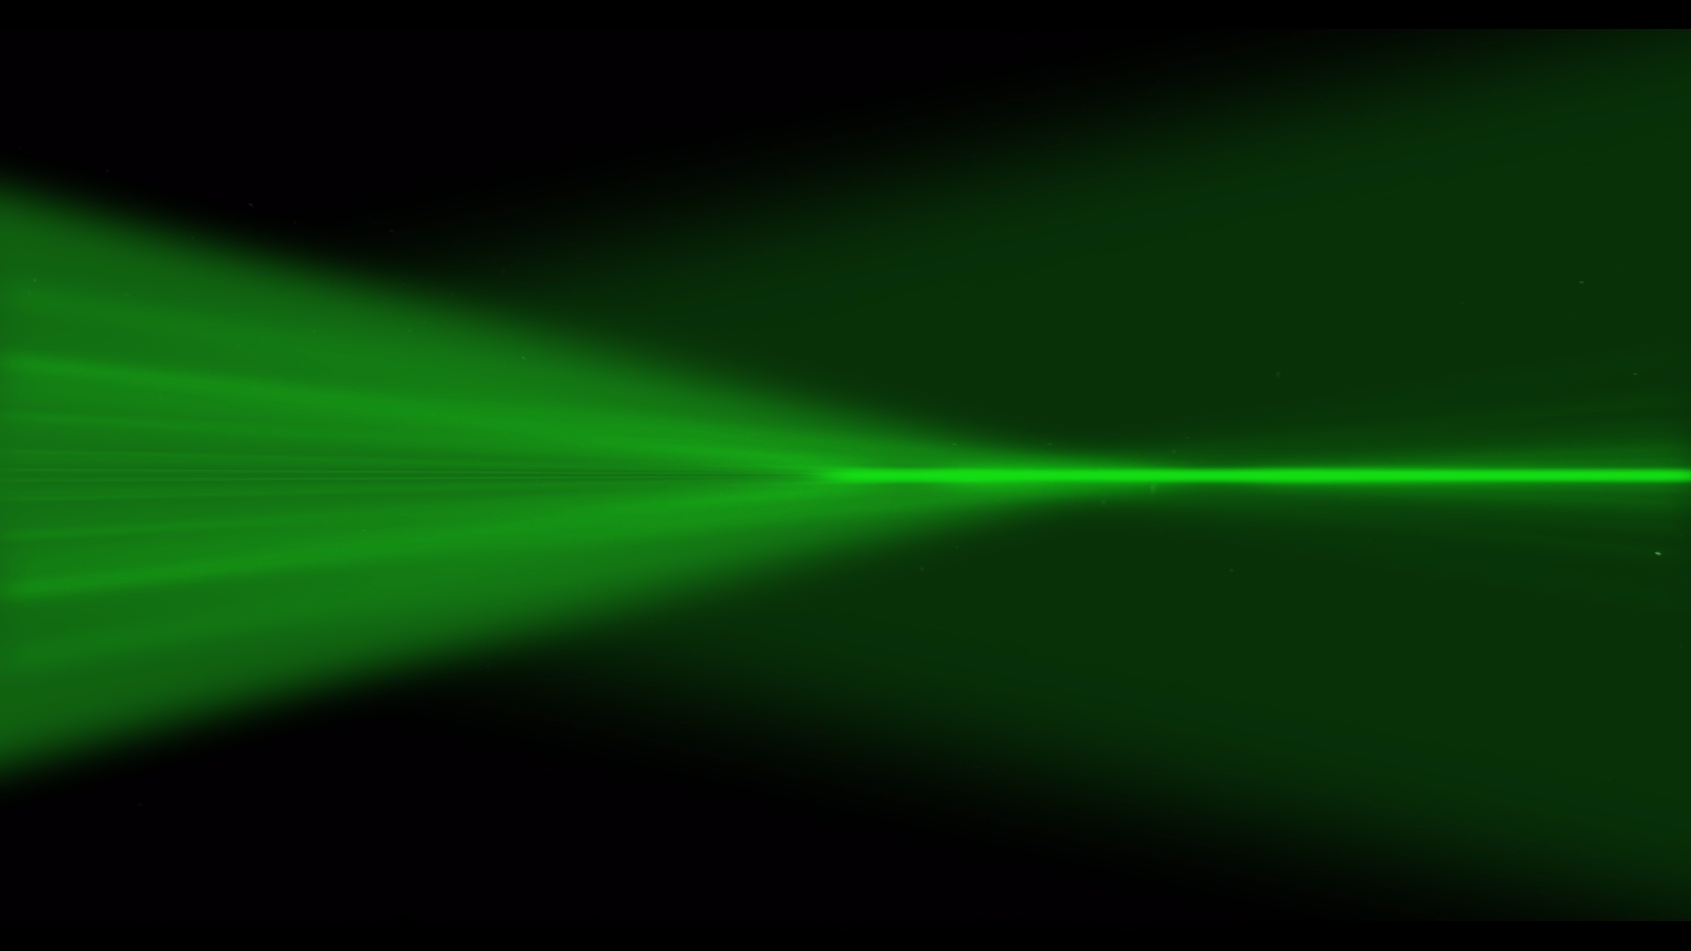
Optical Defocus Coverage
Retina Plane
Neurofocus Optics®
Catenary Power Profile
Defocus treatment area significantly increased >±30°
MKT-NVEM-CE2 r0
Notes:
The Neurofocus Optics® technology uses catenary-curve-like power profile in its design, rapidly and smoothly transitioning to 6 to 8 diopters of relative plus, resulting in a wide spread of myopic defocus that doesn’t cause concentrated hot spots like bifocal designs and covering more than 30 degrees of the retina

Slide 33
Optical Defocus for Myopia Management
Factors That Matter
Magnitude: Relative plus (myopic defocus) dependent
Location: Eccentricity dependent
Duration: Wearing time
MKT-NVEM-CE2 r0
Notes:
Last but not least, the wearing time matters. Which relates to the visual quality and comfort.

Slide 34

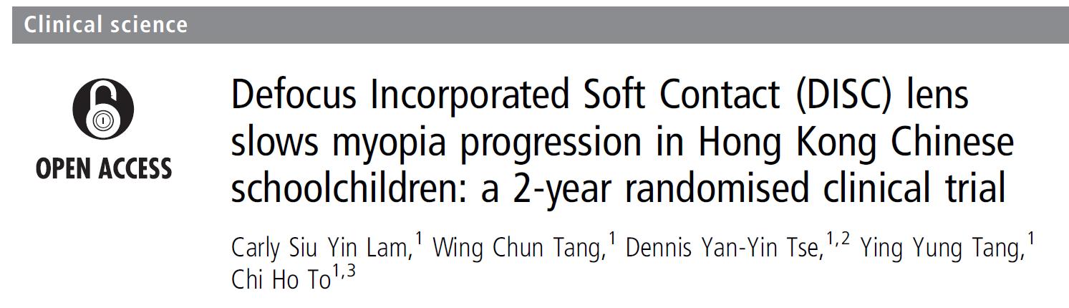

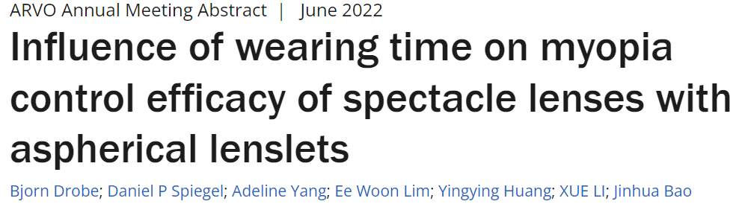
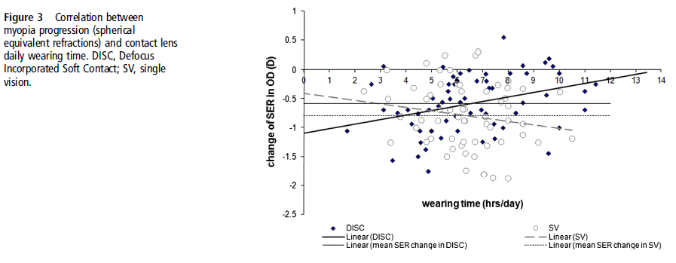
Wearing Time
Myopia Progression Control contact lens and spectacle wearing time correlates with efficacy.
Good visual quality could help keep the kids in their treatment lens.
MKT-NVEM-CE2 r0
Notes:
Required wearing time per protocol was ≥ 10 hrs/day, ≥ 6 days/wk (≥ 60 hrs/wk).
Myopia control clinical trials from both contact lenses and spectacle platforms, have reported the wearing time of treatment devices correlate with treatment efficacy.
Wearing time more or less relates to the visual quality of the lens

Slide 35
Visual Performance in Children
 | Best Corrected | Catenary | p-value
Distance HCHI (VAR) | 102.0 ± 3.1 | 102.2 ± 3.0 | 0.299
Intermediate HCHI (VAR) | 106.9 ± 2.9 | 108.8 ± 3.7 | 0.524
Near HCHI (VAR) | 104.6 ± 3.3 | 106.4 ± 3.1 | 0.101
Distance LCLI (VAR) | 82.9 ± 3.4 | 79.3 ± 3.8 | 0.003
Intermediate LCLI (VAR) | 97.0 ± 2.8 | 96.0 ± 4.9 | 0.372
Near LCLI (VAR) | 95.0 ± 3.2 | 94.3 ± 3.0 | 0.412
Stereo acuity (sec of arc) | 23.8 ± 8.1 | 23.0 ± 5.5 | 0.675
Lag of Accommodation OD | 0.61 ± 0.19 | 0.36 ± 0.24 | 0.002
Lag of Accommodation OS | 0.58 ± 0.20 | 0.38 ± 0.21 | 0.014
20 subjects (age 14.5 ±1.5); OD -3.05 ± 1.56 and OS -3.14 ± 1.53
Catenary optics contact lenses vs Best Corrected spectacle lenses
VAR score100 = 20/20, logMAR 0.00, each letter scores 1 point
MKT-NVEM-CE2 r0
Notes:
Visual Performance:
All multifocal designs will reduce image quality, the question is how much.
In a study that included 20 teenagers (age 14.5 ±1.5) with average refraction of -3.00 D, where their vision was tested with their best spectacle correction and with NaturalVue Multifocal.
Compared with the best-spectacle corrected vision, their vision with NaturalVue Multifocal lenses was preserved under all distances for high contrast letters.
There was only on average 2 letters reduction under low contrast and low illumination distance viewing condition.
The contrast reduction is so minor that it allows spectacle-level Stereopsis.
In addition, Accommodative lag, a risk factor for myopia progression, was found to be both statistically and clinically better, when wearing NaturalVue Multifocal.

Slide 36
Catenary Power Profile for Myopia Management
Magnitude: generates an extremely high magnitude of myopic defocus but is gentle in intensity which preserves visual quality and visual comfort
+6 to +8 D at pupil margin
focuses peripheral light rays from both meridians in front of the retina to reduce peripheral hyperopia^{1, 2}
Eccentricity: the defocus is evenly distributed over 30°
Vision: Minimal image disturbance results in easy neuroadaptation¹⁻³
➔ preserves visual quality (VA, CS, PREP)
➔ preserves stereopsis
➔ reduces accommodative stress
Daily Disposable soft contact lens (etafilcon A)
Optimal Correction
Data suggests that the optimal correction should bring the image inside the retina.
1. Dillehay S, Woods J, Situ P, Payor R, Griffin R, Tyson M, Jones L. (2014). Comparison of Three Power Levels of a Novel Soft Contact Lens Optical Design to Reduce Suspected Risk Factors for the Progression of Juvenile Onset Myopia. Investigative Ophthalmology & Visual Science.; 55(13), abstract 3637
2. Payor R, Woods J, Situ P, Dillehay S, Griffin R, Tyson M, & Jones L. (2014) Feasibility Testing of a Novel SCL Optical Design to Reduce Suspected Risk Factors for the Progression of Juvenile Onset Myopia. Investigative Ophthalmology & Visual Science; 55(13), abstract 3638.
3. Patents Awarded – MULTIFOCAL OPHTHALMIC LENS WITH INDUCED APERTURE. See htts://vtivision.com/about/patents/ for patent numbers.
MKT-NVEM-CE2 r0
Notes:
The Neurofocus Optics® technology has catenary-curve-like power profile
Delivers at least 6 D of relative plus,
The myopic defocus covers a large area of the peripheral retina, including the most sensitive area for myopia control.
With that, the vision is preserved and even reduces accommodative stress.
So, it has all the components of a good myopia control optic. Now, does it work?

Slide 37
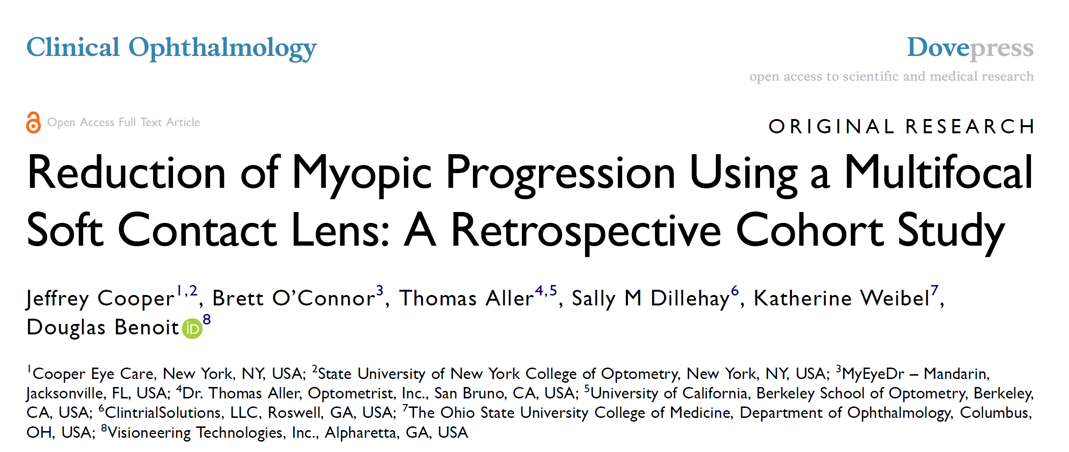
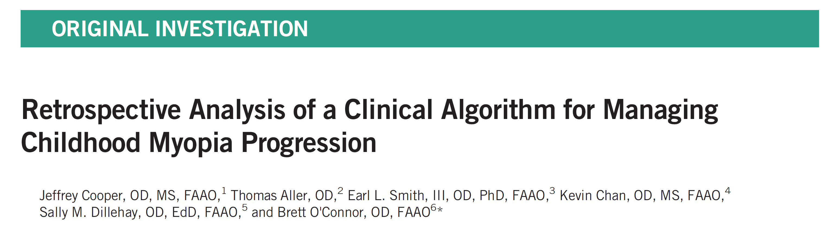

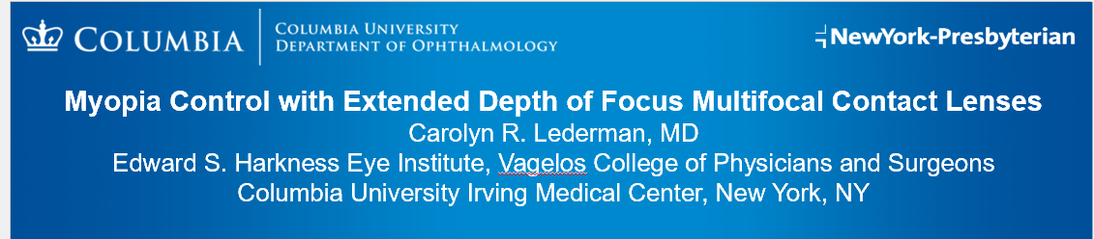
Real-World Data
“6 Year Retrospective”
Clinical Ophthalmology (2022)
“CAMP Study”
Optometry & Vision Science (2023)
“Dr. Lederman Cohort”
AAPOS meeting (2023)
37
MKT-NVEM-CE2 r0
Notes:
We have shared with you the peer-reviewed publication on a 6-year myopia progression study using NaturalVue Multifocal, in Clinical Ophthalmology. Since then, two other independent studies have published their results using NaturalVue Multifocal for myopia progression control.
Treehouse Eyes, is a group of Eye Care Providers specializing in treating myopia progression in the US. Their main tool is ortho-K. However, they do incorporate soft multifocal contact lenses and atropine when needed. In Optometry and Vision Science, Their Clinical Algorithm for Myopia Progression, or CAMP study, included NaturalVue Multifocal data.
In addition, Dr. Carolyn Lederman, a pediatric ophthalmologist in New York, has been treating her patients with NaturalVue Multifocal in the last three years. She presented her results at the American Association for Pediatric Ophthalmology and Strabismus conference recently.

Slide 38
What You Can Expect with Catenary Power Profile

Slide 39
PROgressive Myopia Treatment Evaluation for NaturalVue Multifocal Contact Lens Trial (PROTECT)
Randomized Controlled Trial (duration 3 years)
Sample size: 145 children ages 7 to <13
Spherical Equivalent: -0.75 to -5.00 D, Astigmatism: ≤ -1.00 D, Anisometropia: ≤ 1.00 D
Treatment naïve (no previous ortho-K, atropine, MPC spectacles or contact lenses)
Multi-Center: Canada, US, Hong Kong, Singapore
Double masked: Subject and Outcome measure examiners
NVMF vs SV Control lens (NV sphere) 2 : 1
Control Group will cross over to treatment after 24M
Outcomes
Change of Cycloplegic SER
Change of Axial Length
Safety
Study in it’s third year, all control group subjects crossed over to treatment after 24M

Slide 40
PROTECT Data
24 Months analysis
No device-related Serious Adverse Event
16 subjects exited the study (10 voluntary exits; drop-out=7%)
All available subject data included
Planned Subgroup analysis on enrolled subjects who met a common myopia control study criteria:
age 8 to<13, CSER -0.75 to -4.00D
Covariate analysis identified significant variables:
age, sex, site
VTI-RCT-CN2 r3
Notes:
Due to the optical design, I decided to look at the pupil size impact on outcome variables.
We have found the significant covariates included the classic age and sex variables, and surely enough, the pupil diameter.
We have enrolled 145 subjects, 135 active by the end of 12-month visit.
4 eligibility, 1 lens fit, 5 voluntarily exited the study (drop-out rate 3.4%).
Protocol was designed with both BLINK and MiSight I/E, but we also included in our Statistical Analysis Plan to look at enrolled subjects meet MiSight I/E only.

Slide 41
High and Low Contrast Visual Acuity
All available subjects (ITT)
Both groups had contact lens HCVA 20/20 or better
No change in high contrast distance and near visual acuities from the baseline
One line reduction of low contrast visual acuity
 |  | Dist HC OU | Dist LC OU | Near HC OU
Baseline | SVCL (n = 40) | -0.04 ± 0.05 | 0.11 ± 0.14 | -0.04 ± 0.06
 | NVMF (n = 93) | -0.05 ± 0.06 | 0.09 ± 0.11 | -0.03 ± 0.06
 | p-value | 0.66 | 062 | 0.45
12M | SVCL (n = 40) | -0.04 ± 0.08 | 0.00 ± 0.15 | -0.03 ± 0.05
 | NVMF (n = 93) | -0.04 ± 0.07 | -0.08 ± 0.14 | -0.02 ± 0.04
 | p-value | 0.88 | 0.01 | 0.25
24M | SVCL (n = 40) | -0.06 ± 0.17 | 0.13 ± 0.14 | -0.01 ± 0.05
 | NVMF (n = 89) | -0.03 ± 0.07 | 0.17 ± 0.13 | -0.01 ± 0.05
 | p-value | 0.46 | 0.17 | 0.55
VTI-RCT-CN9 r0
Notes:
* Double check SV LCVA numbers, they are correct, the SD were 0.143 vs 0.135; not the same numbers.

Slide 42
Wearing Time (ITT/All Available Data)
Required wearing time per protocol was ≥ 10 hrs./day, ≥ 6 days/wk. (≥ 60 hrs./wk.).
PROTECT had high compliance rate and were within the range of wearing time in this study, there was no clear relationship between wearing time and progression.
12M Visit (hrs./wk.) | All | SV | MF
n | 131 | 43 | 88
avg | 81.02 | 81.33 | 80.87
sd | 11.73 | 12.60 | 11.35
min | 50.00 | 50.00 | 58.40
max | 108.50 | 108.50 | 106.75
 |  | t-test p value | 0.8415
MKT-RCT-CN5 r0

Slide 43
Safety Results (ITT/All Available Data) Adverse Events
Similar AE% between the two groups
Category | Category | SV Subjects n/N (%) | MF Subjects n/N (%)
Related SAEs |  | 0 | 0
Not Related SAEs |  | 2/42 (4.7%) | 0
Related AEs |  | 9/42 (21.4%) | 28/103 (27%)
Ocular AEs | Corneal Neovascularization | 1/42 (2.4%) | 0
 | Foreign body sensation | 1/42 (2.4%) | 3/103 (2.9%)
 | Dryness | 1/42 (2.4%) | 5/103 (4.8%)
 | Redness | 2/42 (4.8%) | 6/103 (5.8%)
Non-Ocular AEs | Headache | 1/42 (2.4%) | 0
Not Related AEs |  | 20/42 (48%) | 30/103 (28%)
VTI-RCT-CN2 r3
Notes:
There have not been any device-related Serious Adverse Events. There were two non-device related SAE, one broken arm and one was hospitalized due to influenza.
Ocular AEs were low, and the percentages are similar between the two
Large majority of the Not-related AEs is possible COVID symptoms.

Slide 44
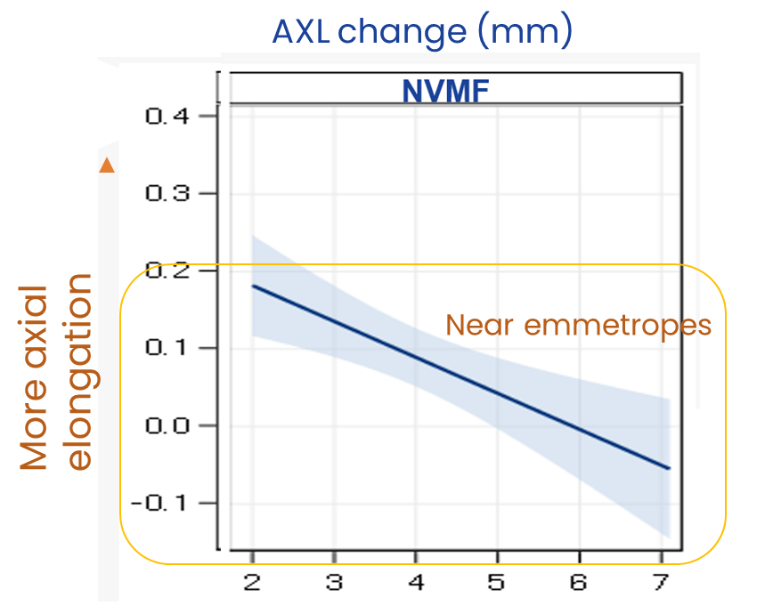
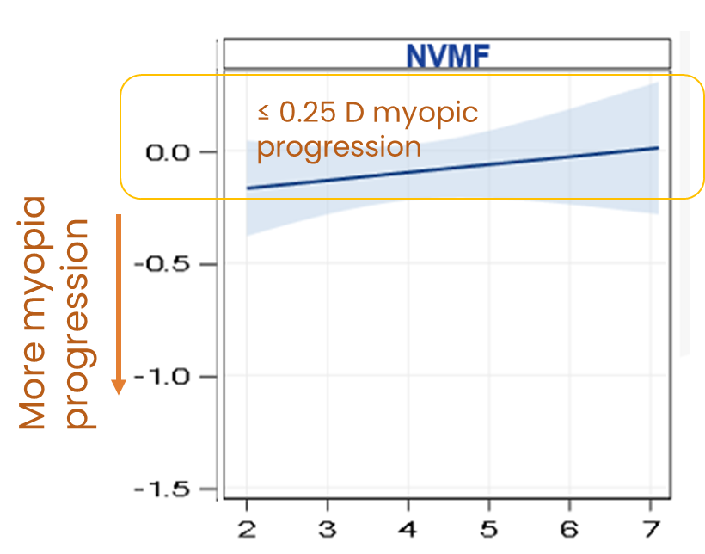
Progression and Pupil Size (12M)
The larger the pupil, the slower the progression
Even small pupils demonstrated control within the “near emmetropic” range performance
Clinical relevance:
All pupil sizes may be effective
May provide continuous treatment when doing near work or outdoor activities (pupil constricts under these conditions)
CSER change (D)
MKT-RCT-CN5 r0
Notes:
Horizontal axis is the pupil size in mm (average 5.7mm)
Vertical axis is the myopia progression (left) and axial elongation (right)
Linear relationship that the larger the pupil, the slower the progression
However, even small pupil, such as 2mm, have demonstrated control in progression (within the “near emmetropic” range)
Dynamic pupil diameters- even kids with large pupils in door, their pupil will constrict when they read (digital devices etc.) and spend time outdoors. This lens design may provide continuous treatment

Slide 45
Study Outcomes (Adjusted for confounding factors): Progression Minimization Continues over 2 Years (PS*)
Adjusted* Tx Effect @ 24M:
0.59 D / 56%
Adjusted* Tx Effect @ 24M:
0.22 mm / 46%
*Planned Subgroup: subjects met MiSight’s age and Rx criteria
**Full Model (adjusted for significant confounding factors): age, country, sex
45
Notes:
3 subjects withdrew last year (2 moved away), making the total dropout 7 (4.8%) to date
24M Preliminary analysis shows…
Adjusted outcome (controlled the age, country and sex confounding-variables), graphically demonstrated continuous retardation of myopia progression both from the cycloplegic refraction perspective and the axial length elongation perspective.
Treatment effect: after taking into account other confounding factors that can impact treatment results, the adjusted treatment effects at 24M were 0.59D for the slowing of myopia and 0.22mm for the retardation of axial elongation. Controlled confounding variables are listed under “Full model”

Slide 46
Proportional Analysis Distribution of Cycloplegic SER Change over 2 years(PS*)
NVMF: 34% Near Emmetropic Change over 24 months (≤ -0.25 D)
(vs SVCL 8%, p<0.001)
34% vs 8%
*Planned Subgroup: subjects met MiSight’s age and Rx criteria
Notes:
≤ -0.25D: 1 year 64%; 2 year 34%
≤ -0.50D: 58%
Statistically significant difference: >=-0.25 (p=0.0001) and <-1.00 (p<0.0001)

Slide 47
Proportional Analysis Distribution of Axial Length Change over 2 years (PS*)
NVMF: 65% Near Emmetropic Change over 24 months (≤0.30 mm)
(vs SVCL 33%, p=0.016)
*Planned Subgroup: subjects met MiSight’s age and Rx criteria
Notes:
Set at 0.20mm interval due to the unadjusted treatment effect was 0.2mm
Emmetropic growth: 1 year (0.125mm) 58%; 2 years (0.30mm) 65%
Statistically significant difference: <=0.20mm (p=0.003) and <=0.30mm (p=0.016)

Slide 48
Myopia Management Summary
PROTECT Randomized Clinical Trial data
The safety profile of the study population is similar between single vision (SV) and multifocal contact lenses (NVMF)
2-year preliminary analysis shows continuous control in myopia progression, corroborating with the NVMF real-world data. In the population of 8 to<13-year-olds, baseline CSER between -0.75D to -4.00D, compared with single vision lenses, NVMF had adjusted value of:
0.59 D (53%) reduction of myopia progression
0.22 mm (46%) retardation of axial elongation
Works for a large range of pupil sizes, clinical settings and populations
*US: NaturalVue® (etafilcon A) Multifocal 1 Day™ Disposable Soft Contact Lenses are indicated for daily wear for the correction of refractive ametropia (myopia and hyperopia), and/or presbyopia in normal eyes. OUS: indicated for daily wear for the correction of refractive ametropia (myopia and hyperopia), and/or presbyopia, and myopia progression control in normal eyes.

Slide 49
Additional Analysis: Patient Reported Outcomes of Children Wearing Catenary Curved Power Profile Multifocal Lenses
Notes:
Total 20 mins, including questions
To assess an intervention’s potential impact and likelihood of success for your patients, you want to look at a full spectrum of scientific evidence.
1. You want to see a proven Mechanism of action.
2. Safety and dosage finding
3. Large randomized control trial to eliminate potential confounding factors and quantify efficacy, with limited enrollment criteria
4. Post-market surveillance: Then the real-world data that is not controlled. – diverse clinical setting, usage and population
Study designs may have unintended oversight.
i.e. gender differences has been discovered in safety and effectiveness responses. Women got overdosed- more adverse effects. Less treatment effects.
https://www.appliedclinicaltrialsonline.com/view/gender-bias-in-the-clinical-evaluation-of-drugs

Slide 50
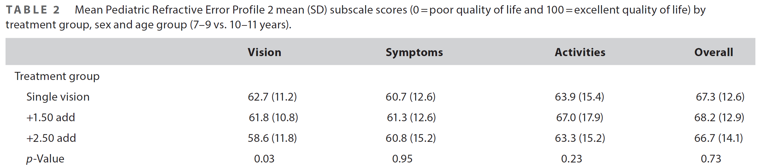
Additional Analysis -Subjective Assessments Patient Reported Outcomes: PREP-2
BLINK data
Validated questionnaire for Myopia Progression Control (Walline et.al.), used in BLINK study (Biofinity MF)
Sensitive enough to tell the difference between + 1.50D and +2.50D Add; 2.50 Add has a reduction of 4 points in Vision score from SV
Confidential
Notes:
We used a validated questionnaire, PREP2, which was validated on children 8-14 with spectacles and contact lenses, and then validated on children 7-11 with single vision and multifocal lenses (part of the BLINK study). It is sensitive enough to detect a statistical difference between +1.50 Add and +2.50 Add on Vision score (difference in 3.2 points). Please refer to the attached publication.
Here are our results. While under the Vision and Symptoms (=Comfort) categories, NaturalVue Multifocal group had higher scores (higher=better), we did not detect a statistically significant difference between the groups. We can conclude that the multifocal lenses did not reduce the subject-reported vision or comfort compared to the single-vision contact lens control group.
8 questions per category, 4 positive and 4 negative questions. Strongly-disagree to strongly-agree.

Slide 51
Patient-Reported Outcomes Patient Reported Outcomes: PREP-2
Validated for the BLINK study, able to separate +2.50D Add from +1.50D Add by 3-4 points
Both groups reported similar scores of Vision, Symptoms, Activities and Overall satisfaction
Both groups improved from the baseline- contact lens wear improves satisfaction
Study Group (Mean±SD) | Vision | Symptoms (Comfort) | Activities | Overall
Baseline (n = 41) | 42.45 ± 11.82 | 52.26 ± 15.0 | 40.32 ± 22.13 | 44.36 ± 20.18
SVCL (n = 41) | 68.06 ± 11.51 | 57.06 ± 19.5 | 79.34 ± 14.42 | 78.36 ± 11.95
Paired p-value | <0.001 | 0.172 | <0.001 | <0.001
Baseline (n = 93) | 46.27 ± 12.45 | 51.88 ± 11.95 | 40.59 ± 20.10 | 44.79 ± 19.09
NVMF (n = 93) | 70.17 ± 12.53 | 61.79 ± 18.01 | 77.78 ± 15.86 | 78.06 ± 14.24
Paired p-value | <0.001 | <0.001 | <0.001 | <0.001
P-value (SVCL vs NVMF) | 0.345 | 0.189 | 0.577 | 0.898
VTI-RCT-CN9 r0

Slide 52
Additional Analysis: Accommodative Accuracy of Children Wearing Catenary Curved Power Profile Multifocal Lenses
Notes:
Total 20 mins, including questions
To assess an intervention’s potential impact and likelihood of success for your patients, you want to look at a full spectrum of scientific evidence.
1. You want to see a proven Mechanism of action.
2. Safety and dosage finding
3. Large randomized control trial to eliminate potential confounding factors and quantify efficacy, with limited enrollment criteria
4. Post-market surveillance: Then the real-world data that is not controlled. – diverse clinical setting, usage and population
Study designs may have unintended oversight.
i.e. gender differences has been discovered in safety and effectiveness responses. Women got overdosed- more adverse effects. Less treatment effects.
https://www.appliedclinicaltrialsonline.com/view/gender-bias-in-the-clinical-evaluation-of-drugs

Slide 53
PROTECT Exploratory Data
Accommodative Accuracy
Monocular Estimated Method (MEM)
ETDRS near-point card, with string (40cm)
Focus on the 20/125 row
Phoria
Cover Test
Distance and Near (40cm)
VTI-RCT-CN9 r0
Notes:
Eyes: OD only at Visits 1 (Manifest/BCSR) and Visits 3,5,7,9 with Assigned CL
Equipment: Retinoscope, loose spectacle trial lenses and/or flippers and/or retinoscope lens bar
Accommodative lag with the manifest refraction in a trial frame is measured at Visit 1 (Baseline) only. At Visits 3,5,7,9, it is measured with the assigned study contact lenses. These measurements are performed by an unmasked examiner on the right eye only with normal accommodation (i.e., NO cycloplegia).
Measurement Procedure
1. Use the LogMAR (ETDRS) nearpoint card. Have the child hold the bead of the string at the outer canthus and the card at the full length of the string. Have the child hold the nearpoint card just slightly below your eye level so that you can observe the reflex with your retinoscope.
2. Have the subject focus on and read the 20/125 row during the testing. This letter size is used because it approximates text size in materials read by children in this age group.
3. Measurements will be made at 40 cm (2.50 D demand) with the child wearing the manifest refraction in a trial frame (Visit 1) or the assigned study contact lenses on eye (Visits 3,5,7,9).
4. Have normal room illumination with the lights on in the examination room.
5. Hold your retinoscope 40 cm from the subject’s eye and tell him/her to remain focused on the letters in the 20/125 row. You and the subject’s eyes should be almost parallel, but the nearpoint card should be a little below the eyes.
6. The retinoscope beam should be oriented vertically.
7. You can have the child read the letters forwards and backwards, name the next letter in the alphabet, etc in order to insure that his/her gaze remains fixated on the nearpoint card.
8. Quickly guide the streak across the subject´s left and right eye and try to evaluate the reflex for WITH or AGAINST motion or for neutrality. Do the test a few times on both eyes to be sure. Estimate the dioptric value required to neutralize the observed motion.
With motion → Add plus lens in front of the eye
Against motion → Add minus lens in front of the eye
9. Confirm the estimate by inserting a lens into the patient´s line of sight (but do not hold the trial lens there longer than one second) while evaluating the reflex. If the correct lens power is chosen, neutrality will be spotted.
10. Repeat the same steps for the other eye.

Slide 54
Phoria
Baseline only
Proportional analysis showed no statistical difference between two groups
 |  | Dist | Near (40 cm)
SVCL | Ortho | 29 (76%) | 22 (58%)
 | Exo | 8 (21%) | 12 (32%)
 | Eso | 1 (3%) | 4 (11%)
 | Phoria range | 10∆ Exo to 0.50∆ Eso | 10∆ Exo to 6∆ Eso
NVMF | Ortho | 67 (76%) | 44 (50%)
 | Exo | 21 (24%) | 37 (42%)
 | Eso | 0 (0%) | 7 (8%)
 | Phoria range | 10∆ Exo to ortho | 10∆ Exo to 6∆ Eso
VTI-RCT-CN9 r0
Notes:
Esophoria >=2: 11 subjects (4 SVCL, 7 NVMF)

Slide 55
Accommodative Accuracy
SVCL: minimum fluctuation (within repeatability)
NVMF: less average accommodative lag than baseline
Study Group | Baseline Mean ± SD | 12M Mean ± SD | 24M Mean ± SD
SVCL (40) | 1.05 ± 0.75 | 0.99 ± 0.71 | 0.83 ± 0.75
NVMF (88) | 1.03 ± 0.84 | 0.76 ± 0.67 | 0.73 ± 0.81
VTI-RCT-CN9 r0

Slide 56
Change from Baseline
Most NVMF Lag within repeatability
Reduced lag from children with higher Baseline accommodative lag
Relaxed accommodation from children with baseline accommodative leads
+1.0D change
No change
-1.0D change
VTI-RCT-CN9 r0
Notes:
X axis is baseline accom, Y axis is 12 month accom
Positive means lag; Negative means lead.
If no change, it will follow the dotted line. Lower than the line means less lag at 12m.
Larger reduction of lag if higher lag at baseline. Some of these kids gave up accommodating at BL and now is working on it because it is not that hard anymore.
Kids with BL accommodative spasm (negative numbers), now are able to relax their accommodation with MF.

Slide 57
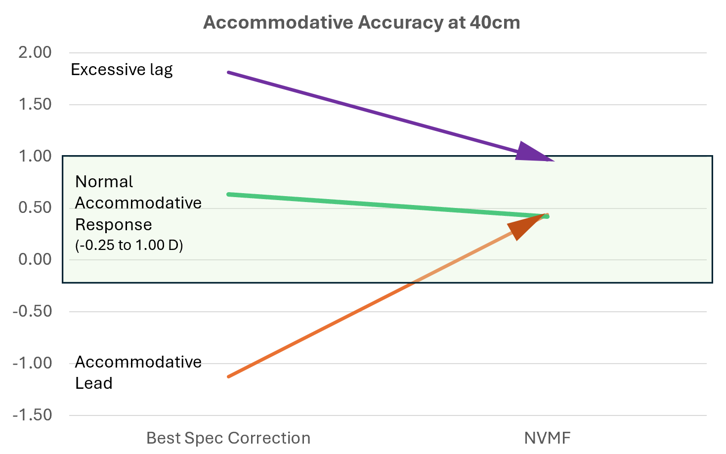
NVMF Improved Accommodative Accuracy:
No noticeable shift from the subjects with normal baseline accommodative response
Baseline Accom Lead or high Baseline Lag shifted towards the normal range

Slide 58

Lens Fitting Method Keys to Fit Success with this Lens Design
Under correction = suboptimal vision
Catenary Curve ➔ Great vision
Simple Refraction: Maximize distance vision
There is no over-minus issue
Provides an extremely high magnitude of myopic defocus but is smooth and gentle in intensity and covers greater than ±30 degrees of retina
Range of DOF
VTI-RCT-CN10 r0
Notes:
Patient retention – 92% repurchase rate

Slide 59
Summary of a Catenary Curved Power Profile CL
Data from a highly aspheric catenary curved multifocal contact lens demonstrated:
Good vision and comfort
Spectacle-level high-contrast visual acuity
Spectacle-level stereopsis
Single vision contact lens level Vision and Comfort
Unmatched EDOF channel
Universal ADD, providing seamless vision for adults with presbyopia
Universal power and axis for astigmatic correction up to 3.00DC
May reduce accommodative stress
Works for Myopia Management
Significantly slowed the progression of myopia (2-year data from an ongoing RCT study)
Works on a large range of pupil sizes, supports indoor and outdoor lifestyles
VTI-RCT-CN9 r0
Notes:
In short, it’s a lens built for real life, serving patients from childhood through adulthood.

Slide 60
Catenary Curved Power Profile Contact Lenses
FDA Indication (on-label):
NaturalVue® (etafilcon A) Multifocal 1 Day Daily Disposable Soft (Hydrophilic) Contact Lenses are indicated for daily wear for the correction of refractive ametropia (myopia and hyperopia) and/or presbyopia in normal eyes … from -20 D to +20 D …who exhibit astigmatism of 2.00 D or less….
mkt-nvem-th6 r1
Notes:
On label to treat the full range of myopia, astigmatism and age

